Slide 1
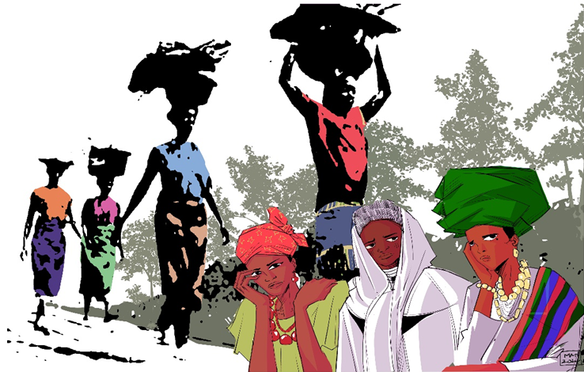
World Day of Prayer Ecumenical Service
Friday 6th March 2026
“I Will Give
You Rest:
Come”
Prepared by the WDP Nigeria

Slide 2
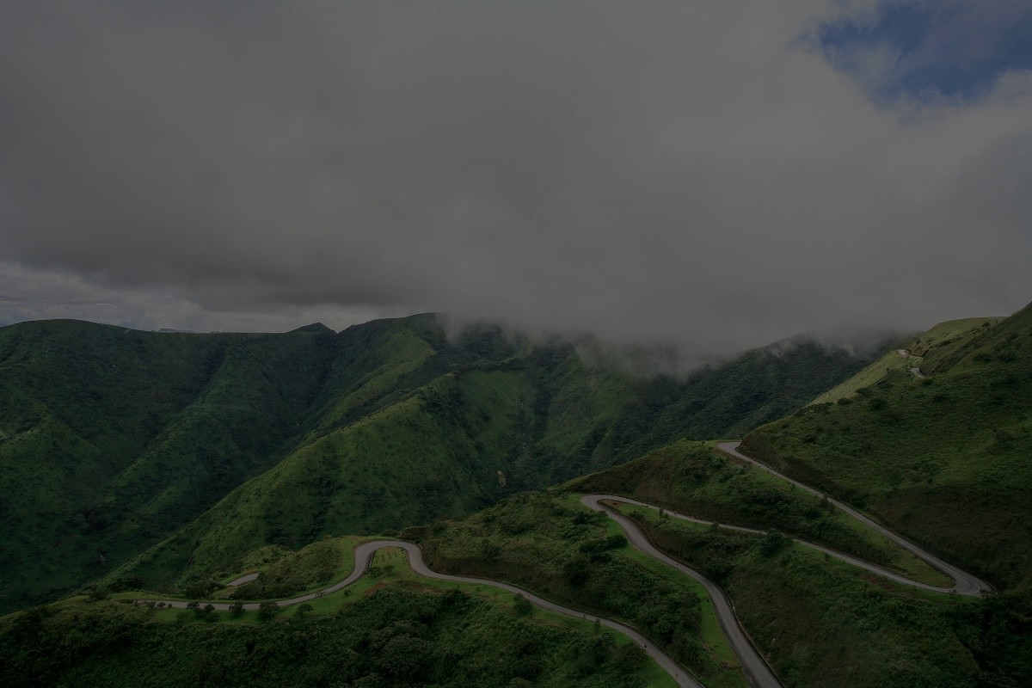
OPENING SONG OF PRAISE
Keleya, keleya nobueze,
keleya keleya nobueze,
kele Jisus nobueze,
Jisus I di nma.

Slide 3
OPENING SONG OF PRAISE
Praise God, praise God,
He’s the King,
Praise God, praise God,
He’s the King,
Praise Jesus, He’s the King, Jesus, you are good.

Slide 5
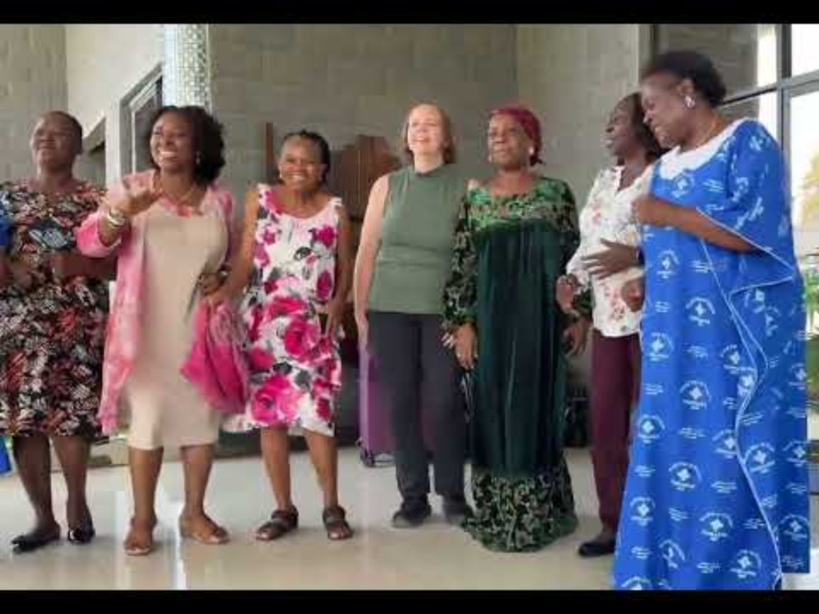

Slide 6
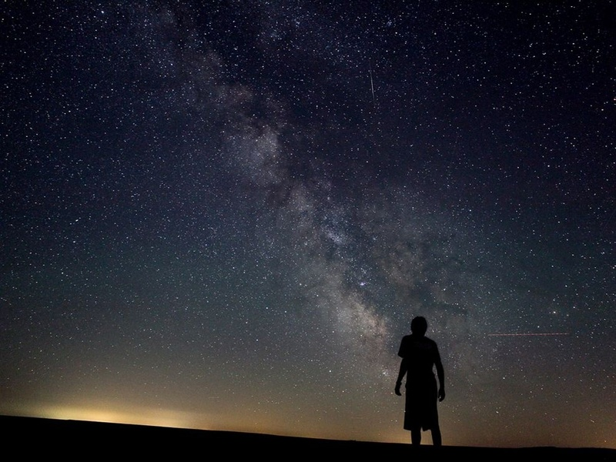
OPENING PRAYER
Let us pray
God, our Burden Bearer, we come before you in praise and adoration! You are the Alpha and Omega, the beginning and the end.

Slide 7
OPENING PRAYER
In you we live and move and have our being.

Slide 8
OPENING PRAYER
We have gathered trusting your promise that where two or three are gathered in your name, we welcome and celebrate your presence in our midst.

Slide 9
OPENING PRAYER
We commit this worship into your hands, praying that you will come among us. Help us be open to the Spirit that you are releasing upon us and let your presence saturate this place.

Slide 10
OPENING PRAYER
In the name of Jesus, we pray. Amen

Slide 12

WORDS OF WELCOME
Welcome, dear friends, to this gathering of people from various communities across the globe. We come together on this day to lift our collective voices, united in prayer and action.

Slide 13
WORDS OF WELCOME
Our theme, I Will Give You Rest: Come, draws inspiration from Matthew 11:28. It serves as a heartfelt invitation from Jesus to all who are burdened and heavy-laden.

Slide 14
WORDS OF WELCOME
And so, you are invited to come, just as you are. Bring all that weighs you down, so that you may find rest.

Slide 15
WORDS OF WELCOME
Christian women from Nigeria are calling out to you, wherever you are in the world, beckoning you to come and find rest for your souls.

Slide 16
WORDS OF WELCOME
As we worship together, may we share each other's burdens and find renewed strength in our unity.

Slide 17
WORDS OF WELCOME
May each of us find a sense of belonging here, as we are united in the embrace of Christ's love.

Slide 19
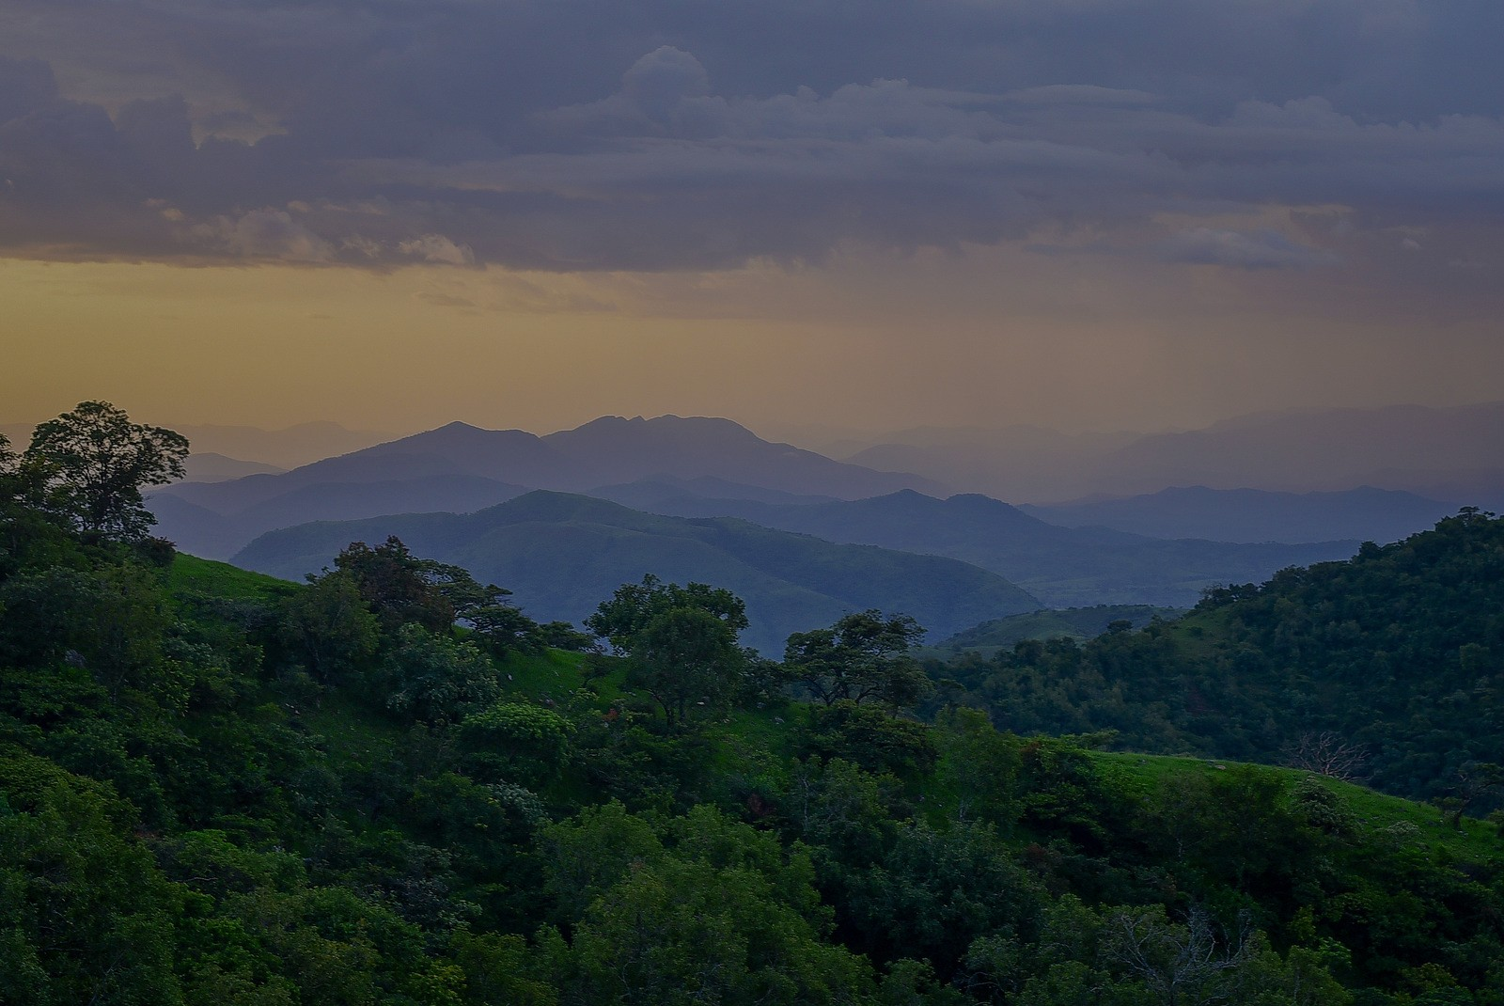
COME UNTO ME
by Chisom R. Chukwumerije (Nigeria)
Are you down and feeling lonely,
are you weary and oppressed,
you don't have to be discouraged,
Jesus says “Come unto me.”

Slide 20
COME UNTO ME
by Chisom R. Chukwumerije (Nigeria)
Come, come unto me,
Come, come unto me,
come, you who are weary,
and I will give you rest.

Slide 21
COME UNTO ME
by Chisom R. Chukwumerije (Nigeria)
Come, come unto me,
Come, come unto me,
Come, you who are burdened, and I will give you rest.

Slide 22
COME UNTO ME
by Chisom R. Chukwumerije (Nigeria)
Tell your brother and your sister
that the Saviour is a friend.
He offers you his shoulder,
lean on him and you'll find rest.

Slide 23
COME UNTO ME
by Chisom R. Chukwumerije (Nigeria)
Come, come unto me,
Come, come unto me,
come, you who are weary,
and I will give you rest.

Slide 24
COME UNTO ME
by Chisom R. Chukwumerije (Nigeria)
Come, come unto me,
Come, come unto me,
Come, you who are burdened, and I will give you rest.

Slide 26
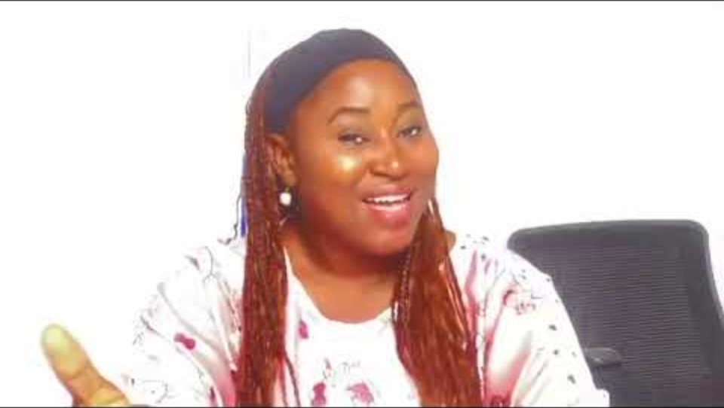

Slide 27
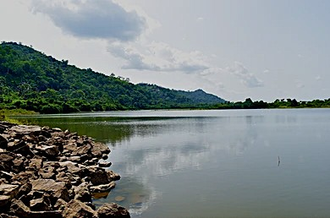
CHIOMA’S BURDEN

Slide 28
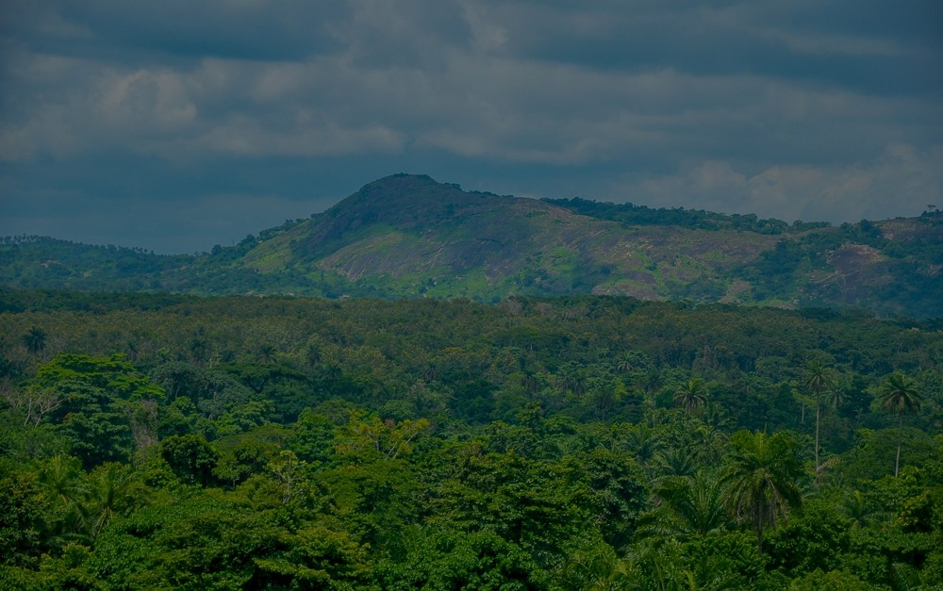
THIS, THIS IS THE GOD WE ADORE
Joseph Hart 1712-68, WITH ONE VOICE 152(ii)
This, this is the God we adore;
our faithful, unchangeable friend;
whose love is as great as His power,
and neither knows measure nor end.

Slide 29
THIS, THIS IS THE GOD WE ADORE
Joseph Hart 1712-68, WITH ONE VOICE 152(ii)
Tis, Jesus the first and last
whose Spirit shall guide us safe home;
we’ll praise him for all that is past,
and trust Him for all that’s to come.

Slide 31

SCRIPTURE READING
Matthew 11:28-30 (NRSV)
Let us now turn our hearts and minds to the words of Jesus found in the Gospel of Matthew. Let us hear these words as a gracious invitation from the very heart of God.

Slide 32
SCRIPTURE READING
Matthew 11:28-30 (NRSV)
“Come to me, all you who are weary and are carrying heavy burdens, and I will give you rest.

Slide 33
SCRIPTURE READING
Matthew 11:28-30 (NRSV)
Take my yoke upon you, and learn from me, for I am gentle and humble in heart, and you will find rest for your souls. For my yoke is easy, and my burden is light.”

Slide 34
SCRIPTURE READING
Matthew 11:28-30 (NRSV)
You are now invited to respond:
Come to Jesus, all you who are weary.
We come.

Slide 35
SCRIPTURE READING
Matthew 11:28-30 (NRSV)
Come to Jesus, all you who are carrying heavy burdens.
We come.
God will give you rest.
God will give us rest.

Slide 36
SCRIPTURE READING
Matthew 11:28-30 (NRSV)
Take on the yoke that Jesus offers.
It is easy. It is light.
We receive this yoke.

Slide 37
SCRIPTURE READING
Matthew 11:28-30 (NRSV)
Learn from the one who is gentle and humble in heart.
We are here to learn.
You will find rest for your souls.
Thanks be to God.

Slide 39
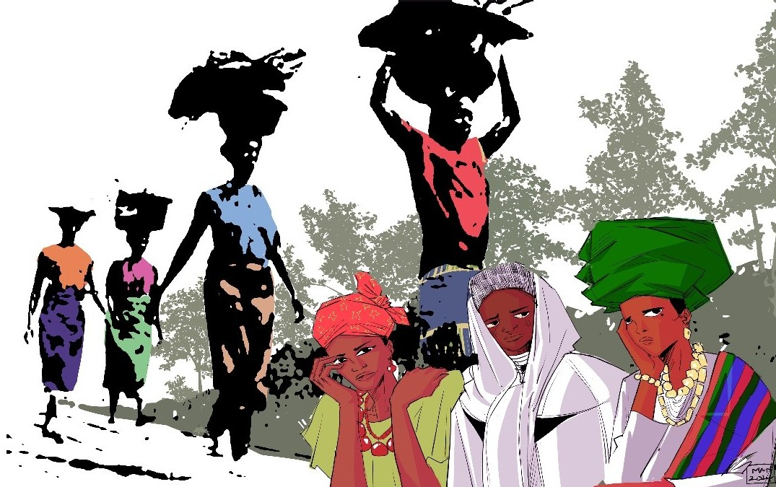

Slide 40
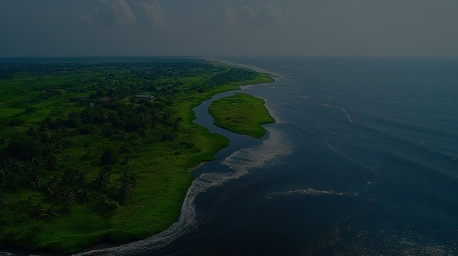
STORIES AND PRAYERS
Dear sisters and brothers in Christ, we have now heard Jesus inviting us to come. To bring our burdens. And to find rest for our souls. And so, we open our hearts now, to listen to three stories of our Nigerian sisters.

Slide 41
STORIES AND PRAYERS
These testimonies reflect their experiences. And they mirror the struggles faced by many around the world.

Slide 42
STORIES AND PRAYERS
There's a proverb used in Nigeria that says, "The pain of one is the pain of all." As we hear these stories, let us remember that what affects each of these women also affects us.

Slide 43
STORIES AND PRAYERS
We'll hear of widows overcoming oppression, mothers finding courage to send their daughters to school, and daily challenges testing people’s faith - experiences that resonate across cultures and borders.

Slide 44
STORIES AND PRAYERS
These stories aren't meant to bring despair. Rather, they show how God truly gives rest even in the most difficult situations.

Slide 45
STORIES AND PRAYERS
May the Holy Spirit speak through these testimonies, inspiring us to lift our voices in prayer with all who carry heavy burdens worldwide.
We are one body in Christ.
When one part suffers, we all suffer.

Slide 46
STORIES AND PRAYERS
But when one finds rest in Jesus, we can all rejoice!
Let's open our ears to hear, our hearts to feel, and our minds to understand.

Slide 47
STORIES AND PRAYERS
The God who invites us to come and find rest is the same God who will use these stories to stir us to powerful, faithful prayer, uniting us across continents in compassion and hope.

Slide 49
GOD IN YOUR GRACE
Words Shirley Erena Murray © 1931-2020, Music Per Harling,
Hope is Our Song 95
Love is your way, love is your nature,
blessing each creature, lighting each day;
grace is your sign, gift of forgiveness,
chalice that changes water to wine –

Slide 50
GOD IN YOUR GRACE
Words Shirley Erena Murray © 1931-2020, Music Per Harling,
Hope is Our Song 95
God in your grace,
God in your mercy,
turn us to you to transform the world,
turn us to you to transform the world!

Slide 51
GOD IN YOUR GRACE
Words Shirley Erena Murray © 1931-2020, Music Per Harling,
Hope is Our Song 95
Pathways we choose, undeserved freedom,
earth as our kingdom, still we abuse;
much we have done, gross human error,
misuse of power darkens the sun –

Slide 52
GOD IN YOUR GRACE
Words Shirley Erena Murray © 1931-2020, Music Per Harling,
Hope is Our Song 95
God in your grace,
God in your mercy,
turn us to you to transform the world,
turn us to you to transform the world!

Slide 53
GOD IN YOUR GRACE
Words Shirley Erena Murray © 1931-2020, Music Per Harling,
Hope is Our Song 95
Terror and tears, wounds without healing,
hearts without feeling mirror our fears;
life without trust, greed and high prices,
conflict and crisis grind us to dust –

Slide 54
GOD IN YOUR GRACE
Words Shirley Erena Murray © 1931-2020, Music Per Harling,
Hope is Our Song 95
God in your grace,
God in your mercy,
turn us to you to transform the world,
turn us to you to transform the world!

Slide 55
GOD IN YOUR GRACE
Words Shirley Erena Murray © 1931-2020, Music Per Harling,
Hope is Our Song 95
Let us stand still, look at each other,
sister and brother thwarting your will:
teach us good care, grace to seek pardon,
reclaim your garden, riches to share –

Slide 56
GOD IN YOUR GRACE
Words Shirley Erena Murray © 1931-2020, Music Per Harling,
Hope is Our Song 95
God in your grace,
God in your mercy,
turn us to you to transform the world,
turn us to you to transform the world!

Slide 58
BEATRICE’S STORY
The Burden of Systemic Oppression
My name is Beatrice. I became a widow at the age of 28 when my husband was killed in a communal clash.

Slide 59
BEATRICE’S STORY
The day I lost him, I lost more than just my partner. I lost my place in society. Suddenly, I was alone with three young children, facing a world that seemed to have turned its back on me.

Slide 60
BEATRICE’S STORY
The struggles I've faced as a widow in Nigeria are overwhelming. Poverty hit us hard. I lost our main source of income and struggled to find work as a single mother.

Slide 61
BEATRICE’S STORY
My in-laws, who I thought would support us, instead treated me with suspicion and tried to take away the little property my husband left behind.

Slide 62
BEATRICE’S STORY
There were days I didn't know how I'd feed my children or pay their school fees.
But in my darkest moments, I found strength in my faith and in the community of other widows.

Slide 63
BEATRICE’S STORY
I remember attending a support programme organized by my local church. They asked for 50 widows to attend, but hundreds showed up. That day, I realized I wasn't alone in my struggles.

Slide 64
BEATRICE’S STORY
What has inspired me most is the resilience and faith of my fellow widows. Despite our hardships, many of us remain committed to Christ, finding solace in knowing Jesus as our Burden Bearer.

Slide 65
BEATRICE’S STORY
I've seen young widows with small children serving tirelessly in the church, their faith unshaken by their circumstances.

Slide 66
BEATRICE’S STORY
One widow in our community, after losing her husband, started a programme to support other widows. She encouraged people to donate clothes, rice, and money to help us.

Slide 67
BEATRICE’S STORY
Her actions inspired me to do the same. Now, I use what little resources I have to support other widows, and together, we're stronger.

Slide 68
BEATRICE’S STORY
Through it all, we remain loyal to our families and the memory of our husbands. While widowers often remarry quickly, we focus on raising our children and keeping our families together.

Slide 69
BEATRICE’S STORY
It's not an easy path, but with faith and community, we find the strength to carry on. Our burden is heavy, but we are learning to lay it at Jesus' feet, finding rest in His promise.

Slide 71
INTERCESSORY PRAYER
Let us pray:
God, you are the Great Burden Bearer. We come before you as your children, from all corners of the world.

Slide 72
INTERCESSORY PRAYER
We lift up our voices, joining with Beatrice and all our siblings who carry the heavy loads of systemic oppression.
God of Compassion, we know that you see us.

Slide 73
INTERCESSORY PRAYER
You see the discrimination faced by so many - women, widows, minorities, the poor.

Slide 74
INTERCESSORY PRAYER
Some are overworked, breaking their backs in factories, fields, and homes, while others cannot find work to feed their families. Gracious God, intervene for us all!

Slide 75
INTERCESSORY PRAYER
Thank you, Gracious God, for the resiliency and resourcefulness of all who remain faithful amidst difficult circumstances. Inspire us by their example and move us to build a better world.

Slide 76
INTERCESSORY PRAYER
Most powerful God, we have seen your hand move before. You parted the Red Sea for your people. Now, part the sea of injustice that drowns so many around the world.

Slide 77
INTERCESSORY PRAYER
Speak to the hearts of leaders everywhere, that they may govern with fairness and compassion. Move the hearts of communities to change their attitudes and actions towards all who are marginalized.

Slide 78
INTERCESSORY PRAYER
Loving Jesus, you welcomed the oppressed and lifted up the downtrodden. Do the same for all who suffer today under oppressive systems.

Slide 79
INTERCESSORY PRAYER
Give us strength to keep trusting you, even when the burdens seem too heavy to bear.
Holy Spirit, fill us anew. Let your power overflow in our communities across the globe.

Slide 80
INTERCESSORY PRAYER
Use us to be a blessing to others. Inspire us by all who use their own struggles to bless those around them.

Slide 81
INTERCESSORY PRAYER
Thank you, Loving God, for hearing our cries and bearing our burdens. We trust in your unfailing love and your mighty power to transform situations.
Amen

Slide 83
WHAT A FRIEND WE HAVE IN JESUS
Joseph Medlicott Scriven 1819-86With One Voice 165
What a friend we have in Jesus
all our sins and griefs to bear,
what a privilege to carry
everything to God in prayer;

Slide 84
WHAT A FRIEND WE HAVE IN JESUS
Joseph Medlicott Scriven 1819-86With One Voice 165
O what peace we often forfeit,
O what needless pain we bear,
all because we do not carry
everything to God in prayer!

Slide 86
JATO’S STORY
The Burden of Religious Persecution
My name is Jato, and I am a Christian mother living in northern Nigeria. Every day when I send my 14-year-old daughter, Amina, to school, my heart tightens with worry.

Slide 87
JATO’S STORY
You see, Amina is the same age as Leah Sharibu was when she was taken from her school in Dapchi, just a few hours from here.
Leah's story haunts me.

Slide 88
JATO’S STORY
A young girl, steadfast in her faith, refusing to deny Christ even in the face of captivity. It's been eight years since Boko Haram took her, and still, she remains their prisoner.

Slide 89
JATO’S STORY
Every time I look at Amina, I can't help but think, "What if it had been her?"
Living under the shadow of religious persecution is not easy.

Slide 90
JATO’S STORY
There are areas where Christians are killed simply for their faith. But by God's grace, we continue to live alongside our Muslim neighbours.

Slide 91
JATO’S STORY
It's not the same everywhere - in Yorubaland in the southwest, Christians and Muslims live together like family

Slide 92
JATO’S STORY
And I know that in some parts of the world, Christians are the ones persecuting other religious groups because of their faith.

Slide 93
JATO’S STORY
I often wonder, what does my faith call me to do in the face of religious persecution? Jesus teaches us to love our enemies, to pray for those who persecute us. It's not easy, believe me.

Slide 94
JATO’S STORY
Some days, when I hear of another attack, another kidnapping, I feel anger rising in my heart. But then I remember - being a Christian means being Christ-like.

Slide 95
JATO’S STORY
These conflicts didn't start yesterday. Even in Jesus' time, there were clashes between different groups. But Jesus showed us a different way.

Slide 96
JATO’S STORY
He calls us to show love, even to those who seem to have no regard for life. At first, this seems like a heavy yoke to bear, but Jesus promises that His yoke is easy and His burden is light.

Slide 97
JATO’S STORY
How do we find that lightness? It's only through God's grace. We carry the yoke of loving our neighbours - even when those neighbours wish us harm. It's not easy, but God's grace sees us through every challenge.

Slide 98
JATO’S STORY
When I pray with Amina each morning before she goes to school, I remind her of Jesus' words: "In this world you will have trouble. But take heart! I have overcome the world."

Slide 99
JATO’S STORY
Our strength doesn't come from an expectation of an easy life. Instead, it's rooted in the knowledge that Christ walks with us through every hardship.

Slide 100
JATO’S STORY
In the face of persecution, we don't simply await rescue; we actively live out our faith, knowing that each act of love and forgiveness is a testament to Christ's enduring power in our lives.

Slide 101
JATO’S STORY
Leah's story reminds us of the cost of this faith. But it also shows us its power. In Damaturu, a small Christian community still gathers to pray for Leah's return.

Slide 102
JATO’S STORY
Their hope, their persistent faith, inspires me to keep believing, to keep loving, to keep living alongside all my neighbours - Muslim and Christian alike.

Slide 103
JATO’S STORY
As I watch Amina leave for school each day, I pray not only for her safety but also for her heart. I pray that she, like Leah, will have the strength to stand firm in her faith.

Slide 104
JATO’S STORY
But I also pray that she will have the love to see the image of God in everyone she meets, regardless of their faith.

Slide 105
JATO’S STORY
This is how we find rest in God - not by harbouring hatred or intolerance, but by letting Christ’s love flow through us, even in the face of persecution. It's a daily choice, a daily surrender.

Slide 106
JATO’S STORY
But in making this choice, we find that our burdens truly do become light, and in God, we find our rest.

Slide 108
INTERCESSORY PRAYER
Let us pray: God of the persecuted and protector of the faithful, we come before you with heavy hearts from Leah's story and the fears of mothers like Jato who send their children to school each day under the shadow of potential violence.

Slide 109
INTERCESSORY PRAYER
Lord Jesus, you faced persecution and stood firm in your faith. We lift up Leah Sharibu and all who suffer for their beliefs.

Slide 110
INTERCESSORY PRAYER
Grant them strength and comfort in their darkest hours, inspiring us to stand strong in the face of adversity.

Slide 111
INTERCESSORY PRAYER
Holy Spirit, we cry out for those displaced by violence, forced to flee their homes and become refugees in unfamiliar lands.

Slide 112
INTERCESSORY PRAYER
Shelter all who are displaced under your wings, providing for their needs and guiding them toward safety and new beginnings.

Slide 113
INTERCESSORY PRAYER
God of justice, we confess the sins that tear at the fabric of our society: the intolerance that breeds fear, the hatred that fuels violence, and the indifference that allows injustice to persist.

Slide 114
INTERCESSORY PRAYER
Break every chain that binds us and separates us from our neighbours.
We cry out against extremism that spreads fear and violence.

Slide 115
INTERCESSORY PRAYER
Touch the hearts of those involved, showing them the value of human life and the path to peace. Comfort those, like Jato, who live with the fear of losing loved ones.

Slide 116
INTERCESSORY PRAYER
Change the hearts of the perpetrators, guiding them toward reconciliation.
Jesus, our Burden Bearer, help us take up your yoke of love and forgiveness.

Slide 117
INTERCESSORY PRAYER
Strengthen us to resist evil, choose love, and be agents of positive change. Renew our minds and hearts, guiding us in righteousness, that we may honour you and bless others, even those who persecute us.

Slide 118
INTERCESSORY PRAYER
We trust in your unfailing love and your power to transform conflicts and hatred.
Amen

Slide 120
WHAT A FRIEND WE HAVE IN JESUS
Joseph Medlicott Scriven 1819-86With One Voice 165
Are we weak and heavy-laden,
cumbered with a load of care?
Jesus is our only refuge:
take it to the Lord in prayer.

Slide 121
WHAT A FRIEND WE HAVE IN JESUS
Joseph Medlicott Scriven 1819-86With One Voice 165
Do your friends despise, forsake you?
Take it to the Lord in prayer;
in His arms He’ll take and shield you,
you will find a solace there.

Slide 123
BLESSING’S STORY
The Burdens of Poverty and Despair
My name is Blessing, and I've lived in Lagos all my life. I've seen Nigeria change over the years, but not in the way we all hoped.

Slide 124
BLESSING’S STORY
We dreamed of progress, of a better life for our children, but instead, we have watched our nation slide deeper into poverty and despair.
Every day, I see the toll this takes on our minds, our spirits.

Slide 125
BLESSING’S STORY
It’s like we are all trapped in a cycle of disappointment. We've been let down so many times that even when good things come our way, we are afraid to believe in them.

Slide 126
BLESSING’S STORY
That's Nigeria now – we've stopped believing that things can get better.
The government seems focused on itself, not on us. Salaries for most people aren't enough to live on, while a select few earn fortunes.

Slide 127
BLESSING’S STORY
A bag of rice – a staple food – is now a luxury for many families. Our young people, bright and full of potential, can't find work. Some fall into despair. And too many are committing suicide.

Slide 128
BLESSING’S STORY
Others turn to crime – kidnapping, banditry, or prostitution – out of desperation.
It's a vicious cycle.

Slide 129
BLESSING’S STORY
Poverty affects our mental health, and poor mental health makes it hard to escape poverty. We're a nation rich in resources, but poor in leadership and hope.

Slide 130
BLESSING’S STORY
But even in the midst of this despair, I see glimmers of light. I think of my neighbour, Grace. She lost her job and her husband the same year.

Slide 131
BLESSING’S STORY
She had every reason to give up, but instead, she started a small business selling homemade soap. It's not much, but it keeps food on her table and her children in school.

Slide 132
BLESSING’S STORY
Grace often tells me, "Blessing, we are not just coping, we are living by faith." Her words remind me of what the Bible says: "Those who are cast down will be lifted up."

Slide 133
BLESSING’S STORY
So, we keep moving, keep believing that one day, the storm will pass.
We keep trusting that God will open another door for us. We continue dreaming and working towards a better future.

Slide 134
BLESSING’S STORY
It's not easy, but we hold onto our faith. It pushes us towards the light at the end of the tunnel.
This is my testimony – that even in our struggles, we see evidence of God's faithfulness.

Slide 135
BLESSING’S STORY
We may be burdened, but we are not broken. We continue to work, to hope, to pray for the Nigeria we know is possible.

Slide 137
INTERCESSORY PRAYER
Let us pray:
Holy God, Giver of life and Sustainer of all, we give you thanks and praise for the persistence of Blessing, and all who keep moving forward despite even the most difficult circumstances.

Slide 138
INTERCESSORY PRAYER
Continue to strengthen and comfort all who are weary from the burdens of life.
God, you know the poverty plaguing many lands. Children go to bed hungry.

Slide 139
INTERCESSORY PRAYER
Families struggle to meet basic needs. We remind you that you are Jehovah Jireh, the Great Provider, and we cry out for your provision. Open doors of opportunity and soften the hearts of those who can help.

Slide 140
INTERCESSORY PRAYER
We lift up all who live with mental health challenges, often exacerbated by poverty, stress, and the difficulties of daily life.

Slide 141
INTERCESSORY PRAYER
When economic conditions worsen and the value of money diminishes, we see more of our sisters and brothers falling into despair.

Slide 142
INTERCESSORY PRAYER
Comfort those contemplating suicide and show them that their lives have immeasurable value in your eyes.
We also pray with those facing other health issues.

Slide 143
INTERCESSORY PRAYER
We especially remember the burden of malaria that still plagues our world, and we pray for better environmental management and healthcare to combat this persistent threat.

Slide 144
INTERCESSORY PRAYER
Ancient of Days, we think of those facing the burden of aging in societies ill-equipped to care for their elders.

Slide 145
INTERCESSORY PRAYER
For those unable to plan for their old age due to economic hardships, we ask for your provision and innovative solutions. Guide us in creating societies that respect and care for the wisdom and needs of older generations.

Slide 146
INTERCESSORY PRAYER
We pray for families and communities struggling to cope with the pressures of life. When stress and hardship make it difficult to support one another, remind us of your endless patience and love.

Slide 147
INTERCESSORY PRAYER
Help us to extend that same grace to those around us.
Jesus, you called us to come with all the burdens that weigh us down. Here we are! Lighten these loads and help us to cast our cares upon you.

Slide 148
INTERCESSORY PRAYER
Holy Spirit, be our Comforter in times of distress. When we cannot see a way forward, be our guide.
Grant us the faith to keep moving forward even when the path seems impossible.

Slide 149
INTERCESSORY PRAYER
Help us to be a light to others, sharing hope and extending a helping hand where we can.
We trust in your unfailing love and your promise that you will never leave us or forsake us.
Amen

Slide 151
WHAT A FRIEND WE HAVE IN JESUS
Joseph Medlicott Scriven 1819-86With One Voice 165
Have we trials and temptations,
is there trouble anywhere?
We should never be discouraged:
take it to the Lord in prayer.

Slide 152
WHAT A FRIEND WE HAVE IN JESUS
Joseph Medlicott Scriven 1819-86With One Voice 165
Can we find a friend so faithful
who will all our sorrows share?
Jesus knows our every weakness:
take it to the Lord in prayer

Slide 154
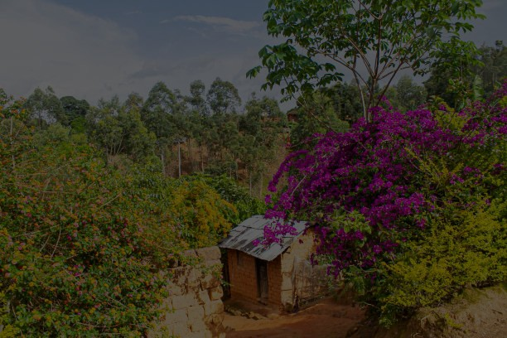
CALL TO ACTION
As we have journeyed through this service, we have become informed about the burdens carried by our sisters in Nigeria and around the world. We have prayed together, bringing these concerns before God, our great Burden Bearer.

Slide 155
CALL TO ACTION
Now, we come to a moment that calls us into prayerful action. The motto of World Day of Prayer is Informed Prayer, Prayerful Action, reminding us that our prayers should lead us to action for the transformation of the world.

Slide 156
CALL TO ACTION
Let us respond to this call together, affirming our commitment to be Christ's hands and feet in a world longing for hope and rest.

Slide 157
CALL TO ACTION
Where do we find our hope in a burdened world?
In Christ, who bears all of our burdens.

Slide 158
CALL TO ACTION
How do we respond to overwhelming situations?
We remain resilient, believing that the storm will pass.

Slide 159
CALL TO ACTION
Where do we place our trust in uncertain times?
In God, the Giver of life and Sustainer of all.

Slide 160
CALL TO ACTION
What should we do when those around us are weary and heavy laden?
Bear one another’s burdens, as Christ bears ours.

Slide 161
CALL TO ACTION
As we go forth, what is our call to action?
To live out our informed prayers through prayerful action.

Slide 162
CALL TO ACTION
May we go forth with the strength of Christ.
We go with faith, hope, and love, to be light in the world.

Slide 164

OFFERTORY
We continue now with a time of giving our financial offerings.
Offering time is a blessed time!
In Nigerian churches, it's customary for people to dance their offerings forward, expressing joy in giving and celebrating God's provision.

Slide 165
OFFERTORY
This act of dancing reminds us that giving is not a burden, but a joyful response to God's grace.
As we give today, let us bring our offerings with that same spirit of joy and thanksgiving.

Slide 166
OFFERTORY
Our offerings this year will support:
Christian World Service – “Climate-Smart Agriculture Practices and Livelihood Initiative for Women in Plateau State, Nigeria.”

Slide 167
OFFERTORY
Our offerings this year will support:
The Bible Society – “The Macedonian Call Project” is a project run by the Bible Society of Nigeria.

Slide 168
OFFERTORY
Our offerings this year will support:
Hospital Chaplaincy Aotearoa

Slide 169
OFFERTORY
Your generous gifts will support the ministry of World Day of Prayer and help address some of the burdens we've prayed about today.

Slide 170
OFFERTORY
Whether you dance, walk, or remain seated as you give, let your offering be a symbol of your commitment to lightening the loads of others.
May our gifts, like our prayers, be a tangible expression of God's love in the world.

Slide 172

HOW MUCH AM I WORTH?
Colin Gibson © 1933-2022, Hope is our Song 63
How much am I worth?
What’s the value in me?
Do I count if I stand or I fall?
If I’m weak or I’m strong,
if I win or I lose,
am I someone, or no one at all?

Slide 173
HOW MUCH AM I WORTH?
Colin Gibson © 1933-2022, Hope is our Song 63
I am worth everything,
everything, everything,
I am worth everything
in the eyes of God;

Slide 174
HOW MUCH AM I WORTH?
Colin Gibson © 1933-2022, Hope is our Song 63
you are worth everything, everything, everything,
we are worth everything
in the eyes of God.

Slide 175
HOW MUCH AM I WORTH?
Colin Gibson © 1933-2022, Hope is our Song 63
I am that bird
that dropped to the ground,
the tiniest bird of them all,
and nobody knew,
and nobody cared,
but our Father, who cares for us all.

Slide 176
HOW MUCH AM I WORTH?
Colin Gibson © 1933-2022, Hope is our Song 63
I am worth everything,
everything, everything,
I am worth everything
in the eyes of God;

Slide 177
HOW MUCH AM I WORTH?
Colin Gibson © 1933-2022, Hope is our Song 63
you are worth everything, everything, everything,
we are worth everything
in the eyes of God.

Slide 178
HOW MUCH AM I WORTH?
Colin Gibson © 1933-2022, Hope is our Song 63
I am that child who felt lost and afraid,
when she saw just how far she had roamed;
but they scoured the hills
till they found her again,
and rejoicing, they brought her safe home.
I am worth everything …
How much am I worth? Do I matter at all?
When I’m thinking it through I may see
that I’m worth all the love of the Son of God,
who laid down his life just for me.
I am worth everything …

Slide 179
HOW MUCH AM I WORTH?
Colin Gibson © 1933-2022, Hope is our Song 63
I am worth everything,
everything, everything,
I am worth everything
in the eyes of God;

Slide 180
HOW MUCH AM I WORTH?
Colin Gibson © 1933-2022, Hope is our Song 63
you are worth everything, everything, everything,
we are worth everything
in the eyes of God.

Slide 181
HOW MUCH AM I WORTH?
Colin Gibson © 1933-2022, Hope is our Song 63
How much am I worth?
Do I matter at all?
When I’m thinking it through I may see
that I’m worth all the love
of the Son of God,
who laid down his life just for me.
I am worth everything …

Slide 182
HOW MUCH AM I WORTH?
Colin Gibson © 1933-2022, Hope is our Song 63
I am worth everything,
everything, everything,
I am worth everything
in the eyes of God;

Slide 183
HOW MUCH AM I WORTH?
Colin Gibson © 1933-2022, Hope is our Song 63
you are worth everything, everything, everything,
we are worth everything
in the eyes of God.

Slide 185


Slide 186
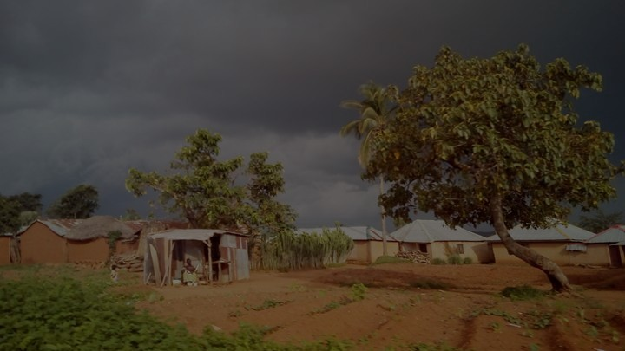
CLOSING WORDS
We are reminded of God's tender care for each of us. Just as God watches over the sparrow, God sees our burdens – the weight of oppression, the pain of loss, the struggles with poverty and mental health.

Slide 187
CLOSING WORDS
Through the stories we have heard, we have witnessed how God works in our lives, offering strength and hope even in the most difficult times.

Slide 188
CLOSING WORDS
Today, we have seen God's hand at work in the lives of our Nigerian sisters. God used Chioma's school friends to remind her of her inherent value, lifting the burden of shame and low self-esteem.

Slide 189
CLOSING WORDS
Through the community surrounding Beatrice, our widowed sister, God demonstrated how love can overcome systemic oppression.

Slide 190
CLOSING WORDS
In Jato's story, we saw how God's strength sustains faith even in the face of persecution, challenging us all to be instruments of peace and understanding.

Slide 191
CLOSING WORDS
And through Blessing's testimony, God revealed how hope and resilience can flourish even amidst poverty and despair.

Slide 192
CLOSING WORDS
As we leave this place, let us remember that God invites us to be co-workers in lifting each other's burdens.

Slide 193
CLOSING WORDS
God calls us to prayerful action - to be the friends who remind others of their worth, the community that supports the vulnerable, the voices that speak for the persecuted, and the hands that offer hope to the struggling.

Slide 194
CLOSING WORDS
Let us collaborate with God in bringing comfort and justice to our world. As the body of Christ, we are empowered by Jesus' promise: "Come to me, all you who are weary and burdened, and I will give you rest."

Slide 195
CLOSING WORDS
This assurance not only gives us peace but also propels us to action. May we go forth as living extensions of Christ, bringing God's rest and relief to all we encounter.

Slide 196
CLOSING WORDS
In this way, we not only find our own rest in God but become channels of that divine rest for others.

Slide 198
YOUR LOVE, O GOD, IS NEVER ENDING
Words Marty Haugen/John Ellerton, Tune CLEMENT C Schofield
Your love, O God is never ending,
throughout the earth its bounty flows,
all life and breath on you depending:
creation’s depth your wisdom shows.

Slide 199
YOUR LOVE, O GOD, IS NEVER ENDING
Words Marty Haugen/John Ellerton, Tune CLEMENT C Schofield
Across each continent and island
as dawn leads on another day,
the voice of prayer is never silent,
nor dies the strain of praise away.

Slide 200
YOUR LOVE, O GOD, IS NEVER ENDING
Words Marty Haugen/John Ellerton, Tune CLEMENT C Schofield
When we’re at rest the sun is waking,
our friends beneath the western sky,
and hour by hour fresh lips are making
your wondrous doings heard on high.

Slide 201
YOUR LOVE, O GOD, IS NEVER ENDING
Words Marty Haugen/John Ellerton, Tune CLEMENT C Schofield
Your love, O God, is world surrounding,
like arms that firmly, gently hold.
Your grace, forever new, abounding,
each day your people to enfold.

Slide 202
YOUR LOVE, O GOD, IS NEVER ENDING
Words Marty Haugen/John Ellerton, Tune CLEMENT C Schofield
Your love, O God, is ever yearning,
to touch and heal a world of pain;
may we in Christ, be ever learning
bringing to birth that love again.

Slide 203
YOUR LOVE, O GOD, IS NEVER ENDING
Words Marty Haugen/John Ellerton, Tune CLEMENT C Schofield
Your love, O God, needs hands and voices;
to hold with care, for justice call.
Help us, O God, through all our choices
to live your love for one and all.

Slide 205
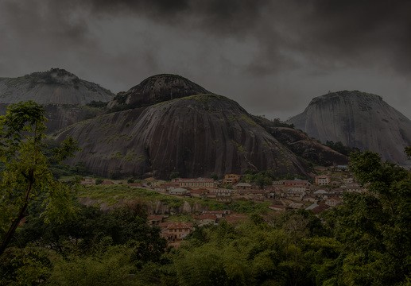
THE GRACE
The grace of our Lord Jesus Christ,
the love of God
and the fellowship of the Holy Spirit
be with us all
now and forever.
Amen

Slide 207
World Day of Prayer Ecumenical Service
Friday 6th March 2026
“I Will Give
You Rest:
Come”
Prepared by the WDP Nigeria

