Slide 1
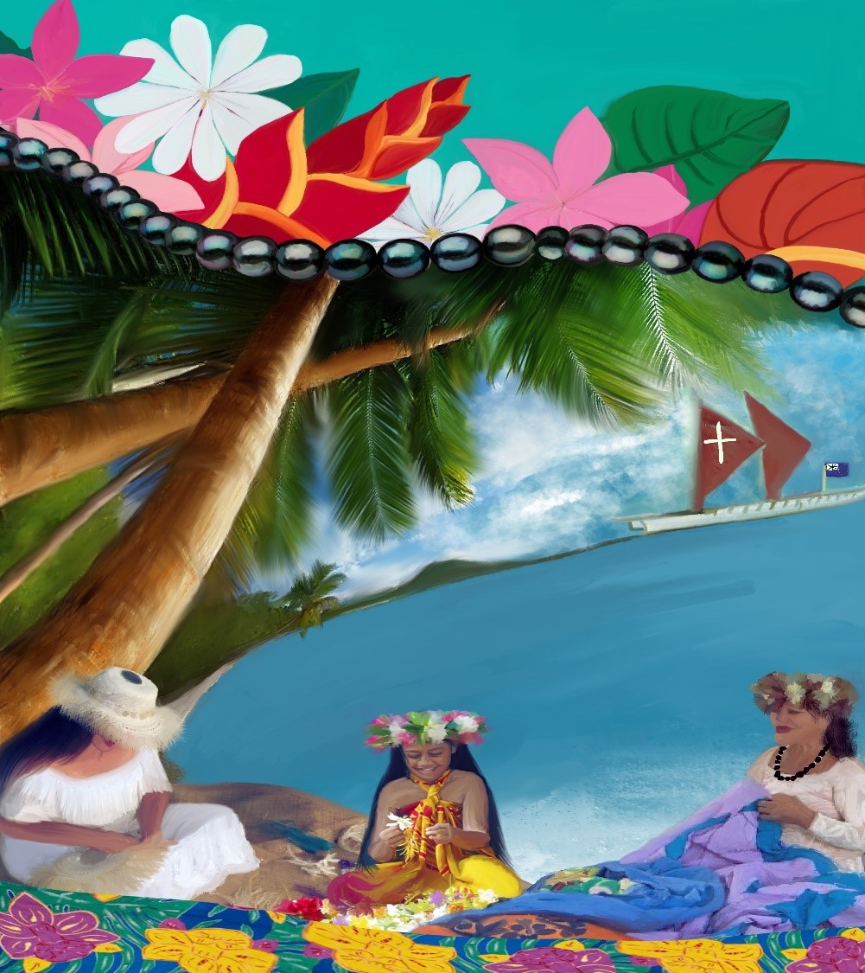
World Day of Prayer
Ecumenical Service
Friday 7th March 2025
“I Made You Wonderfully”
Training Day
Saturday 25th January 2025

Slide 2
Video of Ocean Waves inserted here…
I used https://www.youtube.com/watch?v=BNTs6-pNFRk&t=1510s

Slide 3
Video of Welcome Chant inserted here…
Music – World Day of Prayer

Slide 4
Turoū, turoū!
Oro mai, oro mai!
E te ao nei!
Iēkoko!
Welcome, welcome!
Come all, come all!
The whole world!
Iēkoko!

Slide 5
Welcome And Centering

Slide 6
Kia orana!
Today’s worship service comes to us from a group of ecumenical Christian women from the Cook Islands in the Pacific.
Kia orana is a phrase in the Maori language that Cook Islanders use to greet each other.

Slide 7
Kia orana means more than just hello. It means: May you live long and may you live well. May you shine like the sun. May you dance with the waves.

Slide 8
Our sisters in the Cook Islands have invited the whole world to greet each other today with this Maori phrase.
You are welcome to repeat after me:

Slide 9
Kia orana!
All: Kia orana!
May you live long!
All: May you live long!
May you live well!
All: May you live well!
May you shine like the sun!
All: May you shine like the sun!

Slide 10
May you dance with the waves!
All: May you dance with the waves!
Kia orana!
All: Kia orana!

Slide 11
Take a moment and notice your own breathing.
(pause)
Notice how your breath comes in and out, like the waves of the sea.
(longer pause)

Slide 12
Every one of us gathered here today is breathing! Isn’t that astonishing? All of us share in that gift of life.
As surely as the waves of the ocean rise and fall, our breath flows in and out.
Let us go ahead now and make a BIG wave! Take a deep breath. Engage and feel this sacred and shared gift of life!
(pause)

Slide 13
Kia orana!
All: Kia orana!
Let us take another moment to connect. For this one, you will need your imagination! Imagine the blood flowing through your veins and your arteries. Flowing like rivers.
(pause)

Slide 14
Just as a river brings nutrients to the shores and the fields of the earth, your blood is bringing nutrients to every organ in your body.
(longer pause)

Slide 15
It is amazing that God created our bodies to work this way? To bring health and life to every organ within? To keep us strong, alive and vibrant, each and every day?

Slide 16
Kia orana!
All: Kia orana!
Now, you are invited to find a part of your body that does not hurt too much and try feeling the sensation of your skin dancing through time and space.

Slide 17
You might want to wiggle your fingers!
Or wiggle your toes!
Or perhaps you want to stretch your neck muscles.
Maybe you want to touch the skin on your arm, or your face.
Or maybe you want to simply sit still and notice how the chair/pew is supporting you.

Slide 18
As you engage your body, remember being a child, when you took delight at simply moving through the world.
(longer pause)

Slide 19
God made us wonderfully from the very beginning, weaving us together in our mother’s womb.
And the Spirit continues to flow through every moment of every day, helping us to feel the astonishing gift of life.

Slide 20
Every single one of us is unique, and deeply loved by God. Look around! Look at all who are gathered here today - both in this space, and all around the world. Take a moment to look around and appreciate the gift of each other!
(longer pause as people look around at each other)

Slide 22
Wonderfully Made
I am fearfully made,
And wonderfully made.
Marvelous are your works,
That my soul knows very well,
And I'll praise you all my days.
Ruru Maeva, Cook Islands

Slide 23
Opening Prayer

Slide 24
Let us pray to our Creator.
God who made us wonderfully, thank you for this fellowship of sisters and brothers around the world.
As we come together, help us open our hearts to you, and to each other.
Quiet our minds from all the worries that preoccupy us..

Slide 25
Reconnect us to you, and to each other, so that we all may glow brightly, and radiate your love to the world.
Amen.
Let us listen now to God, through the voices of women from the Cook Islands.

Slide 26
.

Slide 27
Wonderfully Made
I am fearfully made,
And wonderfully made.
Marvelous are your works,
That my soul knows very well,
And I'll praise you all my days.
Ruru Maeva, Cook Islands

Slide 29
Psalm 139:1-6
New Revised Standard Version
The Inescapable God

Slide 30
O LORD, you have searched me and known me.
You know when I sit down and when I rise up;
you discern my thoughts from far away.
You search out my path and my lying down
and are acquainted with all my ways.

Slide 31
Even before a word is on my tongue,
O LORD, you know it completely.
You hem me in, behind and before,
and lay your hand upon me.
Such knowledge is too wonderful for me;
it is so high that I cannot attain it.

Slide 34
Story 1: God Knows Us
Woman 1: Kia orana.
My name is Mii. I am 15 years old.
February 2022 was a scary month for me. It was the month that my family first had contact with someone who was Covid-19 positive.

Slide 35
When I first heard about it, I freaked out. My dad felt bad because he was the one who brought it into our home. I was really upset. I thought we were going to die. I knew people who had died from COVID. I thought that I would die and not see my nephew when he was born.

Slide 36
I started to think about things that I haven’t experienced yet. I started to pray. I pleaded with God to look after my family. I didn't know what would happen next. I turned to the Lord and asked for guidance. I was terrified and scared, but I knew that prayer would help me to feel calm.

Slide 37
And it worked. I stopped crying and the pressure lifted from my heart.
And then I realized that God knows every detail of my life. God knows my distress and fear. God knows. And knowing that God knows and cares about me helps me to feel calm when I am afraid.

Slide 38
God knows me. And God knows you. And God knows everything we are going through.

Slide 39
Now Thank We All Our God
With One Voice 14, verse 1
(Martin Rinkart 1586-1649, tr. Catherine Winkworth 1827-78 alt, Later form of melody Johann Cruger 1598-1662)

Slide 40
Now thank we all our God,
with hearts and hands and voices,
who wondrous things hath done,
in whom his world rejoices;
who from our mothers’ arms
hast blest us on our way
with countless gifts of love,
and still is ours today.

Slide 42
Psalms 139:7-12
(New Revised Standard Version)

Slide 43
Where can I go from your spirit?
Or where can I flee from your presence?
If I ascend to heaven, you are there;
if I make my bed in Sheol, you are there.

Slide 44
If I take the wings of the morning
and settle at the farthest limits of the sea,
even there your hand shall lead me,
and your right hand shall hold me fast.
.

Slide 45
If I say, “Surely the darkness shall cover me,
and night wraps itself around me,”
even the darkness is not dark to you;
the night is as bright as the day,
for darkness is as light to you.

Slide 48
Story 2: God is With Us
Woman 2: Kia orana.
My name is Vainiu.
I was born in 1958 on the island of Aitutaki. My parents and grandparents believed strongly in the value of culture for a good upbringing.

Slide 49
I attended Araura Primary School. For the first 3 years of my education, Cook Islands Maori was the language of instruction. However, as I moved on in school, it became clear that a lot of importance was placed on the English language.

Slide 50
Sadly, the schools that I attended encouraged us to speak English in our classes and in the playground. We were told by our teachers not to speak our mother tongue. We were told to immerse ourselves in the English language.

Slide 51
Unfortunately, many at the time believed that English was the universal language, the language of trade, and therefore the language of superiority. The influence by the West in those days was powerful. I struggled with this, as I was fluent in Maori and spoke little English.

Slide 52
My grandmother, Mama Mereana, encouraged her grandchildren to speak Maori. I looked up to Mama Mereana. She had a huge impact on my childhood. She was my mentor and role model in the way of life.

Slide 53
It was through her that I learned valuable and lifelong skills of how to plant and prepare food, and to speak the Reo Aitutakian dialect properly. I strongly believe that our elders play a significant role in shaping who we are and where we come from.

Slide 54
The English language has gained momentum over the years and the value of our Maori language has diminished. Formal education during the early years of my life did not have a positive impact on me because what I learned at home from my parents, grandparents and family contradicted what I was taught by my teachers in a Western classroom.

Slide 55
The books and lessons that we read and learned from were all in English. I used to think to myself, how are these English books and lessons going to help me plant vegetables, make the umu (ground oven), cook food, wash the clothes and feed the chickens and pigs. A strong feeling of loss led me to withdraw from engaging in the classroom.

Slide 56
One time in school, I remember being caught speaking our indigenous language. My teacher punished me by making me wear a cardboard sign that said, “I am a Maori speaker.” She put me on detention and, on a hot day, made me pull out prickly weeds called “pikikaa” on the school playground.

Slide 57
I was humiliated and shamed in front of my peers. I never forgot that day. As a result of that experience, I was determined to speak English and say little about my mother tongue. This is just one example of how my language and culture was devalued.

Slide 58
God gave us unique and special languages throughout the world, and we should honour and respect those languages. I believe that the Maori language needs to be paramount in our teaching and learning environment.

Slide 59
Teachers and students can encourage Maori to be spoken, taught and written in all subjects. And parents can give our Maori language a chance to survive by speaking it at home.

Slide 60
During those formative years in my childhood, even though I was devalued and shamed by the school system, I know that God was still with me. Even when we are cast out and treated with disrespect, God is still with us. God goes with us to the darkness at the bottom of the ocean, where there is no light.

Slide 61
And God helps lead us out of that darkness into a wonderful light.
Kia orana e kia manuia.
Thank you for listening to my story.
God bless you.

Slide 62
Now Thank We All Our God
With One Voice 14, verse 2
(Martin Rinkart 1586-1649, tr. Catherine Winkworth 1827-78 alt, Later form of melody Johann Cruger 1598-1662)

Slide 63
O may this bounteous God
through all our life be near us,
with ever joyful hearts,
and blessed peace to cheer us;
and keep us in his grace,
and guide us when perplexed,
and free us from all ills
in this world and the next.

Slide 65
Psalms 139:13-18
(New Revised Standard Version)

Slide 66
For it was you who formed my inward parts;
you knit me together in my mother’s womb.
I praise you, for I am fearfully and wonderfully made.
Wonderful are your works;
that I know very well.

Slide 67
My frame was not hidden from you,
when I was being made in secret,
intricately woven in the depths of the earth.
Your eyes beheld my unformed substance.

Slide 68
In your book were written
all the days that were formed for me,
when none of them as yet existed.
How weighty to me are your thoughts, O God!
How vast is the sum of them!

Slide 69
I try to count them—they are more than the sand;
I come to the end—I am still with you.

Slide 72
Story 3: God Made us Wonderfully
Woman 3: Kia orana.
My name is Dr. Dawn
Becoming a doctor was one of the hardest things I have ever done.

Slide 73
But it is worth it when a mother shares that her child is now healthy and thriving after I did my part in helping to save that child’s life. It truly warms my heart. One time, a girl who had not seen me for over 10 years came up and hugged me, saying I am still her “baby doctor.”

Slide 74
I enjoy working with children so much. They give me strength to go on serving at a time when the Cook Islands faces the threat of our workforce leaving the country.

Slide 75
I graduated as a doctor in 2003 after 7 years of studying in Fiji. At that time, there was a focus on building up paediatrics in the Cook Islands. I became the first female Cook Islands doctor at the Paediatric Department of the Cook Islands, after my predecessor Dr Henry Daiwo.

Slide 76
I would also like to mention Dr. Munro who looked after our paediatric ward previously.
One of my first priorities as a baby doctor was to make sure all babies got a check-up by our team within 24 hours. I also helped us to become more equipped and skilled to handle very sick and premature newborns.

Slide 77
We established guidelines and protocols to help direct our work. We improved the connection between the Cook Islands and our great supporters from Auckland and Starship Hospital in New Zealand. Having more specialised care has been a major factor in improving the health of our children.

Slide 78
We pride ourselves on being the only Pacific Island country to have no maternal deaths since 1995.
Other areas of our healthcare system in the Cook Islands have also improved over the decades. Specialised care has greatly improved since the 1990s as the focus moved from infectious diseases to curative medicine.

Slide 79
Our screening programmes for cervical and breast cancers have greatly improved. However, there is still work to be done. We must focus on offering better primary health care and preventing noncommunicable diseases and pandemics. We need to focus on mental health. We need to strengthen support systems for our elderly.

Slide 80
Our teenage pregnancies still need to be addressed. Although accessibility to contraception is relatively easy, the uptake needs more encouragement. Our communities must act and take accountability for their own health. Health and wellness are a job for everyone. We can only improve if we work together.

Slide 81
God created me wonderfully by blessing me with the motivation and opportunity to study medicine. And I responded to God’s blessing by serving the people of the Cook Islands as a doctor. As I have worked in healthcare over the years, I realize more and more that God has made all of us wonderfully.

Slide 82
Our bodies, minds and spirits were knit together by our loving Creator. I am fearfully and wonderfully made. You are fearfully and wonderfully made. We all are fearfully and wonderfully made.

Slide 83
Now Thank We All Our God
With One Voice 14, verse 3
(Martin Rinkart 1586-1649, tr. Catherine Winkworth 1827-78 alt, Later form of melody Johann Cruger 1598-1662)

Slide 84
All praise and thanks to God
the Father now be given,
the Son, and Holy Ghost,
one Lord in highest heaven:
the one eternal God,
whom earth and heaven adore;
for thus it was, is now,
and shall be evermore.

Slide 86
Reflection
“I Made You Wonderfully”

Slide 88
Intercessory Prayers

Slide 89
As we come to our time of prayer, let us prepare our hearts to come before God. When we pray, we deepen our relationship to God. And when we deepen our relationship to God, we become more connected to all of God’s creation.
Let us open our hearts and spirits to God.

Slide 91
Wonderfully Made
I am fearfully made,
And wonderfully made.
Marvelous are your works,
That my soul knows very well,
And I'll praise you all my days.
Ruru Maeva, Cook Islands

Slide 92
Wonderfully Made
You are fearfully made,
And wonderfully made.
Marvelous are God’s works,
That my soul knows very well,
And I'll praise God all my days.
Ruru Maeva, Cook Islands

Slide 93
Wonderfully Made
We are fearfully made,
And wonderfully made.
Marvelous are God’s works,
That we now know very well,
And we'll praise God all our days.
Ruru Maeva, Cook Islands

Slide 95
God Who Knows Us
God who knows us,
God who is with us,
God who made us,
to you we pray.
Ruru Maeva, Cook Islands

Slide 98
Magnificent God, we stand in awe of you. We give you glory because of who you are – the Creator of the entire world. You created the beautiful Cook Islands - the fertile lands, the mountains, and the oceans. And you created beauty in every part of the world.

Slide 99
You created roosters on the land, and whales in the sea. And you formed us - human beings - fearfully and wonderfully made in your image.
All of creation reveals Your majestic glory.

Slide 101
Lord You Have Searched Me
With One Voice 90, verse 1
John Hatton ? 1795 The Psalter Hymnal 1927 alt. Tune Duke Street

Slide 102
Lord, you have searched me, and you know
where’er I rest, where’er I go;
and you know all that I have planned,
and all my ways are in your hand.

Slide 104
Faithful God, thank you for taking care of us in every moment of our lives. You have been with us in our fear and our anxiety. Our depression and our frustration. You have helped us bear financial limitations and uncertainties about the future.

Slide 105
You have been present with us through cyclones and tsunamis, wildfires and earthquakes. You held us through the COVID-19 pandemic that affected the physical and mental well-being of so many.
.

Slide 106
God, thank you for all the women leading our powerful prayer movement. We praise you for the mamas who have passed the World Day of Prayer baton from the past into the present.
God of Abundance, we are truly grateful for you. And we cannot help but praise You for your faithfulness.

Slide 108
Lord You Have Searched Me
With One Voice 90, verse 2
John Hatton ? 1795 The Psalter Hymnal 1927 alt. Tune Duke Street

Slide 109
My words from you I cannot hide;
I feel your power on every side;
Such wondrous knowledge, aweful might,
Unfathomed depth, unmeasured height!

Slide 111
God of Mercy, we come before you with humble hearts seeking Your forgiveness of our many sins – in word, in deed, and in thoughts. We have spoken unkind words to those around us, neglecting to treat them as wonderfully made by you.

Slide 112
We have polluted the oceans and destroyed the environment, neglecting to care for your beautiful creation. Our pride and lack of courage have caused harm to ourselves and others. All of this has caused us to miss out on your blessings and love.

Slide 114
Lord You Have Searched Me
With One Voice 90, verse 3
John Hatton ? 1795 The Psalter Hymnal 1927 alt. Tune Duke Street

Slide 115
Where can I fly apart from you?
Where can I from your presence go?
In heaven? It is your dwelling fair:
In death’s abode? You still are there.

Slide 117
Gracious God, please hear the longings of our hearts. Re-create your character and image within us. Open our spiritual eyes and minds to accept our divine beauty. And inspire us to share this beauty with others. God, help us to honour the divine beauty in everyone, appreciating each person that you have created.

Slide 118
Wise Teacher/Patient God, help us to recognize that you are always present, no matter what circumstances we face. Loving Spirit, we need your embrace, so that we might shine and radiate your love to the whole world.

Slide 120
Lord You Have Searched Me
With One Voice 90, verse 4
John Hatton ? 1795 The Psalter Hymnal 1927 alt. Tune Duke Street

Slide 121
If I the wings of morning take,
and far away my dwelling make,
I find your right hand leading me,
Your presence still supporting me.

Slide 123
God of Wisdom, we pray for the leaders in our world. Guide their hearts and minds to have integrity as they make decisions. Inspire them and bless them with vision to move our world towards unity and peace.

Slide 124
We pray for women and girls who are vulnerable in our societies. Create the conditions so that elderly women can live with respect and dignity. Give our young women the education, aspiration and vision to develop into a promising future. Provide strength, courage and patience to all women experiencing domestic violence.

Slide 125
God of Healing, restore us to wellness. Heal us from physical diseases such as cancer, diabetes, and heart disease. Relieve us from mental illness and heal our emotional wounds. Protect us from the selfishness and greed that threaten our spiritual well-being.

Slide 126
God, help our World Day of Prayer movement unite our communities in prayer. Help us make your love visible. Strengthen us to continue loving and supporting all who are in need. Lead us to treat others as wonderfully made by you, so that all people would feel that they are important, cared for, and treasured.

Slide 128
Lord You Have Searched Me
With One Voice 90, verse 5
John Hatton ? 1795 The Psalter Hymnal 1927 alt. Tune Duke Street

Slide 129
And if the darkness covers me
and light as darkness seems to be,
to you there’s neither day nor night:
the darkness is as clear as light.

Slide 131
Now let us continue by singing the Lord’s Prayer in Maori, the heart language of our sisters from the Cook Islands. After we sing, we will speak the Lord’s Prayer in our own heart languages.

Slide 132
Video of Lord’s Prayer inserted here…
https://www.youtube.com/watch?v=4YWbrCAgBP8

Slide 133
The Lord’s Prayer
Our Father who art in heaven
Hallowed be Thy Name
Thy Kingdom come
Thy will be done on earth as it is in heaven.

Slide 134
Give us this day our daily bread
And forgive us our trespasses
as we forgive those who trespass against us
And lead us not into temptation
but deliver us from evil

Slide 135
For Thine is the Kingdom,
the Power, and the Glory
Forever and ever
Amen

Slide 138
Today we have been blessed by the witness of Christian women from the Cook Islands. The three stories they shared have connected us to their lives. These women from the Cook Islands have given generously of their time and talents to make this World Day of Prayer not only possible, but beautiful.

Slide 139
We come now to a time of offering.
The World Day of Prayer is a movement led by Christian women that unites the world in prayer. As we pray with our sisters from the Cook Islands, we are moved to prayerful action. Giving our financial resources is one way we can act so that all women and girls can live with dignity and respect.

Slide 140
Our offerings this year will support:
Christian World Service – Tongan Community Development Fund, and its work with the Amatakiloa women’s groups in Tongan Village communities.

Slide 141
The Bible Society – Bible Society of the South Pacific – Healing the wounds of trauma in the South Pacific.
Interchurch Council for Hospital Chaplaincy in New Zealand.

Slide 142
While we are giving our offering, let us enjoy this imeni tuki – or sacred hymn – by our siblings in the Cook Islands.
May we open our hearts and give generously.

Slide 143
Video of Congregation Singing inserted here…
https://www.youtube.com/watch?v=Jdqv4LKXPks

Slide 145
Let us pray.
God, we dedicate this offering to you. Thank you for all the gifts you have given to us. Bless the gifts we offer now to you, so that they may bless the world. Amen.

Slide 148
A Mutual Blessing

Slide 149
As a second part of our offering, and in response to all that has been shared today, let us take a moment to greet a few people around us.

Slide 150
You can start by saying “Kia orana!” And then you can say something that you love about that person. After you say what you love about the person, you can end by saying “God made you wonderfully!”

Slide 151
If you know the person well, you might say “Kia orana! I love how you treat everyone with kindness and respect! God made you wonderfully!”
Or, “Kia orana! You are the best cook I know! God made you wonderfully!”
Or, “Kia orana! I love how dedicated you are to your kids. God made you wonderfully!”

Slide 152
If you don’t know them very well, you might say “Kia orana! I love your smile! God made you wonderfully!”
Or “Kia orana! I love your shirt! God made you wonderfully!”
So, let’s offer a mutual blessing to each other now.

Slide 155
Wonderfully Made
I am fearfully made,
And wonderfully made.
Marvelous are your works,
That my soul knows very well,
And I'll praise you all my days.
Ruru Maeva, Cook Islands

Slide 156
Wonderfully Made
You are fearfully made,
And wonderfully made.
Marvelous are God’s works,
That my soul knows very well,
And I'll praise God all my days.
Ruru Maeva, Cook Islands

Slide 157
Wonderfully Made
We are fearfully made,
And wonderfully made.
Marvelous are God’s works,
That we now know very well,
And we'll praise God all our days.
Ruru Maeva, Cook Islands

Slide 160
Commitment To ‘Prayerful Action’

Slide 161
So what now?
What happens when we realize that God is with us and for us?
What changes when we recognize that we are fearfully and wonderfully made?

Slide 162
What we believe often becomes our reality.
When we think differently, we live differently.
Changing the way we think changes the way we act.

Slide 163
Each one of us is God’s masterpiece. How will that realization cause us to live differently?
Like Mii, when we realize that God knows us, we can find peace amidst our fears.

Slide 164
Like Vainiu, when we trust that God is always with us, we can find strength even in the midst of struggles.
And like Dr Dawn, when we understand that we are unique and special, made wonderfully by God, we can use our gifts and talents to serve and bless the world.

Slide 165
Our motto in World Day of Prayer is “Informed Prayer, Prayerful Action.”
So let us take one last moment together.
As we listen again to the ocean waves, let us ask how God is calling us into a new way of being in the world – into “prayerful action.”

Slide 166
Video of Ocean Waves inserted here…
I used https://www.youtube.com/watch?v=BNTs6-pNFRk&t=1510s

Slide 169
‘Your love, O God is never ending’
(Words vv 1,4,5,6: Marty Haugen / ‘The day you gave us Lord, has ended.’ (Words vv 2,3: John Ellerton 1870. Tune: Clement C Scholefield, 1874)

Slide 170
Your love, O God is never ending,
throughout the earth its bounty flows,
all life and breath on you depending:
creation’s depth your wisdom shows.

Slide 171
Across each continent and island
as dawn leads on another day,
the voice of prayer is never silent,
nor dies the strain of praise away.

Slide 172
When we’re at rest the sun is waking,
our friends beneath the western sky,
and hour by hour fresh lips are making
your wondrous doings heard on high.

Slide 173
Your love, O God, is world surrounding,
like arms that firmly, gently hold.
Your grace, forever new, abounding,
each day your people to enfold.

Slide 174
Your love, O God, is ever yearning,
to touch and heal a world of pain;
may we in Christ, be ever learning
bringing to birth that love again.

Slide 175
Your love, O God, needs hands and voices;
to hold with care, for justice call.
Help us, O God, through all our choices
to live your love for one and all.

Slide 178
Blessing

Slide 179
Go now, and live this good news:
God is our Creator.
God made us wonderfully.
God knows us, and God is with us.

Slide 180
Treat yourself as a precious
and beloved child of God.
And treat others as precious
and beloved children of God.
Amen!

Slide 182
Video of ‘Wonderfully Made inserted here…
https://www.youtube.com/watch?v=ZxiWitGCjbI

Slide 183
Video of ‘God who knows us’ inserted here…
https://www.youtube.com/watch?v=RaoAKafFHVQ

Slide 184
World Day of Prayer
Ecumenical Service
Friday 7th March 2025
“I Made You Wonderfully”
Training Day
Saturday 25th January 2025

