Slide 1
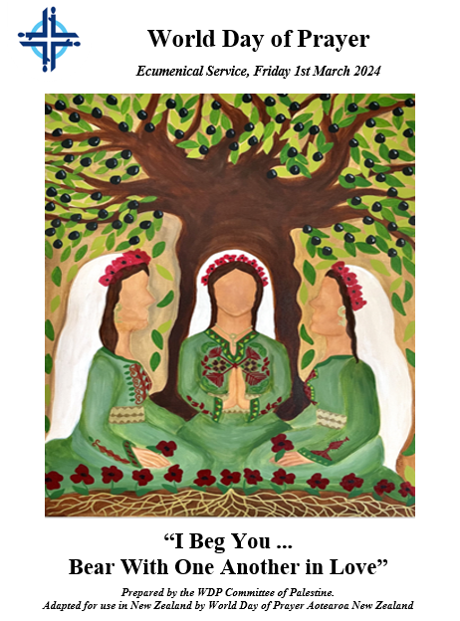
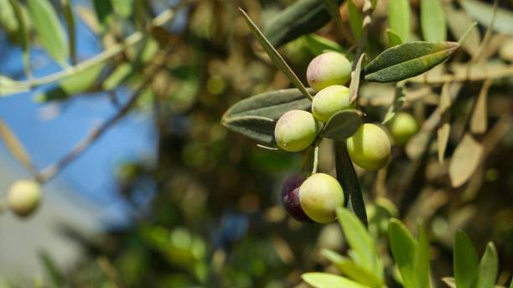
Welcome

Slide 2
Welcome
Background Music:
“I Urge You”
(Najwa Hashway Azazian)

Slide 3
Welcome and Greetings

Slide 4
Salaam. Peace be with you.
30 years ago, the women of World Day of Prayer Palestine were invited to write on the theme of “Come, See and Act.” Since Palestine is the land where Christianity was born, the women of World Day of Prayer Palestine were invited again to write the programme for this year.

Slide 5
A group of ecumenical Palestinian Christian women have worked collectively the last 4 years to pray and reflect on the theme “I Beg You… Bear With One Another in Love,” inspired by
Ephesians 4:1-7. And now, they are inviting all people around the world to join them in prayer and action.

Slide 7
Salutation and Response

Slide 8
We gather in the Name
of the Triune God,
Creator, Son and Holy Spirit.
All: Amen.
God be with you.
All: And also with you.

Slide 10
Opening Prayer

Slide 11
Let us pray
Triune God, walk with us as we journey
through the land where you lived and taught.
Open our eyes to see the present suffering of the inhabitants of this land.
Grant us the strength and courage to act and pray with all who suffer
around the world. Amen.

Slide 12
Prayer for Peace:
“Yarabba ssalami” (God Of Peace)
God of Peace, come among us,
Rain down your peace on the world.
Make a path for your goodness,
Fill e’vry heart with your peace.

Slide 13
Let us continue in prayer with the words of Psalm 85.
Lord, you were favourable to your land;
you restored the fortunes of Jacob.
All: You forgave the iniquity of your people;
you pardoned all their sin.

Slide 14
You withdrew all your wrath;
you turned from your hot anger.
All: Restore us again,
O God of our salvation,
and put away your indignation toward us.

Slide 15
Will you be angry with us forever?
Will you prolong your anger to all generations?
All: Will you not revive us again,
so that your people may rejoice in you?

Slide 16
Show us your steadfast love, O Lord,
and grant us your salvation.
All: Let me hear what God the Lord will speak,
for he will speak peace to his people,
to his faithful, to those who turn to him in their hearts.

Slide 17
Surely his salvation is at hand for those who fear him,
that his glory may dwell in our land.
All: Steadfast love and faithfulness will meet;
righteousness and peace will kiss each other.

Slide 18
Faithfulness will spring up from the ground,
and righteousness will look down from the sky.
All: The Lord will give what is good,
and our land will yield its increase.

Slide 19
Righteousness will go before him,
All: and will make a path for his steps.

Slide 20
Prayer for Peace:
“Yarabba ssalami” (God Of Peace)
God of Peace, come among us,
Rain down your peace on the world.
Make a path for your goodness,
Fill e’vry heart with your peace.

Slide 22
Call to Worship

Slide 23
Let us praise God who brings us together to worship in love and unity.
All: Unity in the Triune God, transcending differences in views and theological interpretations.

Slide 24
Let us remember these essential qualities of people of faith: humility, gentleness, patience and love.
All: We confess our weakness and failure to accept others without judging them.

Slide 25
With humility and patience, we bear the challenges in our families, society, community and church.
All: With gentleness and love,
we overcome everything.
We remain strong in our faith,
knowing that we belong to God.
Amen.

Slide 27
Gospel Reading: John 15:12-14

Slide 28
“This is my commandment, that you love one another as I have loved you. No one has greater love than this, to lay down one’s life for one’s friends. I am giving you these commands so that you may love one another.”

Slide 30
A Story of Resilience: Eleonor’s story (Old Woman)

Slide 31
My name is Eleonor.
My skin is wrinkled like the trunk of an olive tree. Like them, I have witnessed many wars and violence.
I am a Palestinian Christian – a member of the Greek Orthodox Church in the Holy Land.
I come from a deeply rooted old Jerusalem family.

Slide 32
In the early 19th century, my great grandfather established St. George’s Orthodox Church, which enabled Christians living outside the city walls to have a place to worship.
That church remained in existence until the catastrophe, or Nakba, of 1948, when 750,000 Palestinians were forced to flee, disperse and become refugees.

Slide 33
My family was included. Due to heavy shelling and bombardment, my parents ran for their lives. They took shelter at my mother’s cousin’s home, hoping to return soon to their original home and St. George’s Church.
That never happened.

Slide 34
Today, my parents’ home and St. George’s Church have become the Confederation House, an Israeli cultural centre.
Prior to fleeing, my parents’ Jewish neighbours offered to store the treasures of the church, including icons and precious communion cups.

Slide 35
They promised to safeguard my parents’ property and belongings until the family’s return. As my brothers and I were growing up, my parents remembered their neighbours graciously as they waited for the big day of return. They imagined themselves collecting these sacred items and thanking these neighbours for keeping their promise.

Slide 36
Sadly, my parents have passed away without realizing this dream. And yet, I vividly remember that, despite their pain and suffering over all they had lost, my parents were always thankful and spoke kindly about these Jewish neighbours. My parents taught me how to bear with others in love, always remembering to be grateful for those who do good.

Slide 37
As I have gone through life as a Palestinian Christian living in Jerusalem, I have chosen to be fully engaged with all members of the community at local and global levels. I learned from my parents’ example how important it is to stay together with others, even when life is harsh and difficult.

Slide 38
My commitment to my community started when I was in 6th grade. My Arabic teacher engaged me in running errands for her humanitarian work. She was gentle and loving, which helped me grow to value and love working to make life better for others.

Slide 39
Later in life, I designed and implemented humanitarian aid and development programmes, as well as social and community projects. These programmes and projects served all people, regardless of religion, ethnicity, gender, status or need.

Slide 40
I was privileged to help hundreds of women in Jerusalem, the Gaza Strip and the West Bank to sustain their families as breadwinners. Many of these projects have grown and spread to other areas, positively impacting many lives.
Life has not always been easy. I have setbacks, obstacles, and even threats.

Slide 41
However, I firmly believe that our community can be strong together if there is genuine love, understanding, gentleness, humility and patience.
Since my childhood, I have known that life is fragile, and peace is not a guarantee.

Slide 42
I could have left the country of my roots, but I made the choice to stay and live out Jesus’ commandment to love others as God has loved me.

Slide 44
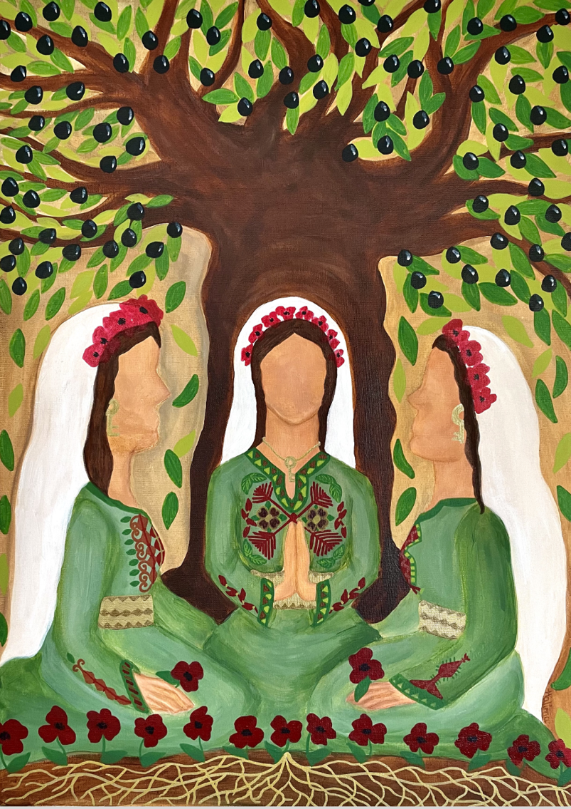
WORLD DAY OF PRAYER 2024
WRITTEN BY THE WOMEN OF PALESTINE
"I Beg You… Bear With One Another in Love” Ephesians 4:1-3

Slide 45
Epistle Reading: Ephesians 4:1-7

Slide 46
“I therefore, the prisoner in the Lord, beg you to lead a life worthy of the calling to which you have been called, with all humility and gentleness, with patience, bearing with one another in love, making every effort to maintain the unity of the Spirit in the bond of peace.

Slide 47
There is one body and one Spirit, just as you were called to the one hope of your calling, one Lord, one faith, one baptism, one God and Father of all, who is above all and through all and in all. But each of us was given grace according to the measure of Christ’s gift.”

Slide 49
Reflection

Slide 50
In Paul's address to the Ephesians, he begs the community to bear with one another. The word “beg” is a strong word. It can also be translated from the Greek as “implore,” “urge,” or “request.” This word tells us something about Paul and his relationship to the Ephesians.

Slide 51
Despite being an authority figure for the Ephesian church, Paul does not order or command the Ephesians. He begs them, treating them as the higher and more powerful party in the relationship. This is a gesture of great respect and humility. It suggests that Paul loves this community greatly, and that what he is asking is more important than pride and protocol.

Slide 52
And what is Paul asking? He is asking the Ephesians to live a life worthy of their calling. To be worthy of their calling, the Ephesians must live with humility and gentleness and patience. To be worthy of their calling, the Ephesians must bear together in love.

Slide 53
Living under occupation, Palestinians know how hard it is to bear together in love. Occupation attempts to divide Palestinians from each other. When some Palestinians are given privileges that other Palestinians are denied, it divides the community. When some Palestinians have more freedom of movement than others, it divides the community.

Slide 54
When some Palestinian faith leaders are treated better than others, it divides the community. Although bearing together in love under occupation is a challenge, Palestinians are determined to remain a community. Another aspect of this theme that is difficult for Palestinians is the question of who is included in “one another?”

Slide 55
Do we also have to “bear in love” with those who are doing evil to us, and to others? When children in Hebron are arrested simply for walking to school, must we bear with our oppressor in love? When young people are beaten for speaking Arabic in Jerusalem, must we bear with our oppressor in love?

Slide 56
When people are not allowed to pass through military checkpoints to visit family or go to work, must we bear with our oppressor in love? It is difficult to hear Paul’s words to “bear with one another in love” in the face of injustice. In Arabic, the word for “bearing” is hamel, which literally means “to carry.”

Slide 57
It is a word used in many contexts, including when a woman is pregnant. Women bear life, bringing human beings into the world. And women bear so much more: not only work, family, and community, but also the weight of inequality placed on them by patriarchal societies. Gender-based violence and discrimination creates an unjust burden for women around the world.

Slide 58
Today, some churches around the world, including in Palestine, are working for gender justice. These churches believe that women and men are created equally in God’s image (Genesis 1:27), and that in Christ, there is no longer male and female (Galatians 3:28). Bearing with women in love means treating them as human beings worthy of dignity and justice.

Slide 59
Bearing with women in love means lifting up their voices, callings, and leadership.

Slide 61
Silent Meditation: Let us reflect now on the ways that God is moving us to bear one another in love: • What challenges does each one of us bear? • What do women bear in our cultures, community and church? • What are ways we bear with each other?

Slide 63
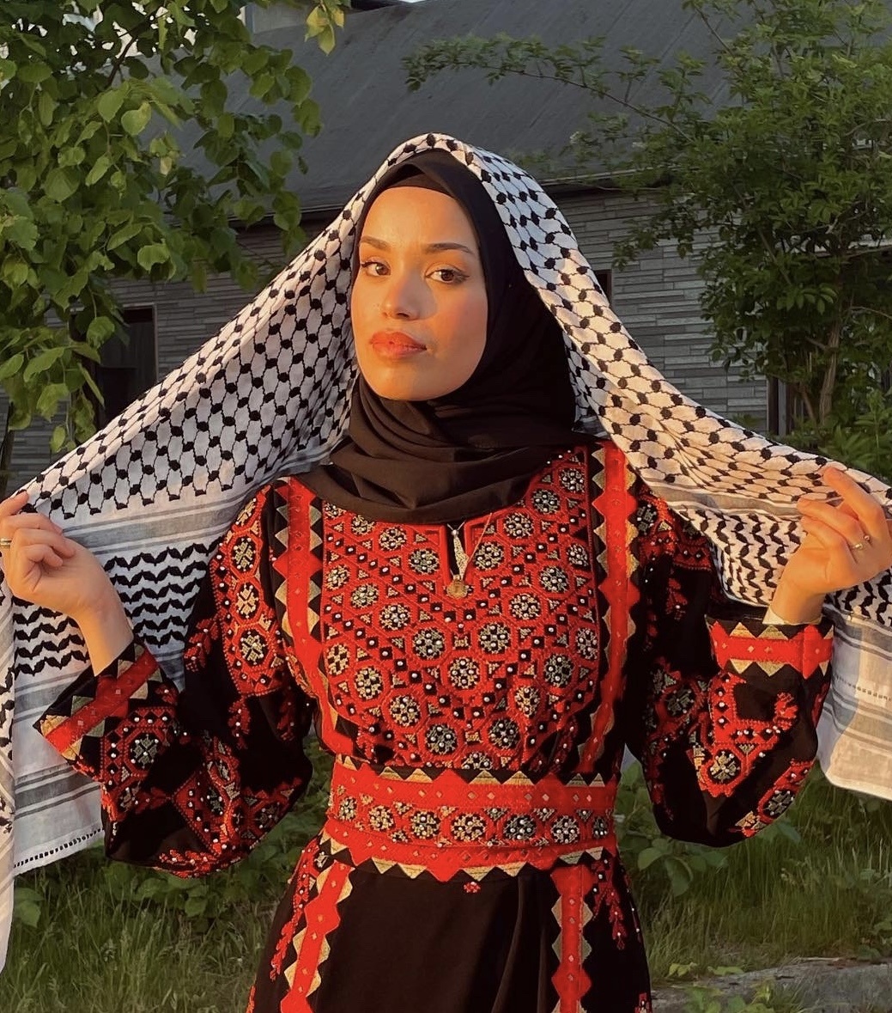
Art & Artist
Halima Aziz

Slide 64
“I Urge You”
I Urge You is a song that was composed especially for this World Day of Prayer service.

Slide 65
English Translation: I urge you to be patient with the calling you receive, bearing one another with love and unity.

Slide 67
A Story of Truth Telling: Lina’s story (Younger Woman in her 20s)

Slide 68
My name is Lina.
On May 11, 2022, I lost my Aunt Shireen, a famous journalist who was killed in Jenin. For me, Aunt Shireen was like the branch of an olive tree, resisting the strong winds that threatened to erase the truth of Palestinian experience.

Slide 69
When Aunt Shireen died, Palestine lost an icon, a legend, and a famous Al Jazeera journalist. And yet, Shireen is all of the above and more. She was also my aunt, my godmother at baptism, and my best friend. Shireen has been my role model for as long as I can remember. She was also a role model to many young Palestinian women.

Slide 70
Growing up, I aspired to be as successful, professional, and empathetic as her. I will cherish all the moments I spent with her talking about art, politics, and life, watching shows, going on vacations, and spending time with the family.

Slide 71
For 25 years, Aunt Shireen dedicated her life to telling the stories of Palestinian experience, and to being the voice of truth. She entered every house in Palestine and the Arab world through the TV screen. The day of her funeral was proof that she had also entered the hearts of Palestinians.

Slide 72
The outpouring of solidarity we witnessed at her funeral will forever be ingrained in my memory and the collective memory of Palestine. We are forever grateful to the strong and courageous Palestinians who resisted the threats from Israeli forces and carried Shireen’s casket on their shoulders.

Slide 73
Many people did not know that my aunt was a Palestinian Christian. Shireen’s faith led her to bear with all in love, despite differences in faith traditions. She stood with all who were being harmed. She struggled for both Muslims and Christians to have access to the holy sites in Jerusalem.

Slide 74
Her truth telling was even a way of bearing with the occupiers in love. Speaking the truth is a form of loving resistance, because it calls the oppressor back to their humanity.

Slide 75
Although Shireen, a branch of the olive tree, was cut down too soon, her legacy lives on. Her memory now nourishes the earth, from which we will gain strength to continue telling the truth and demanding justice.

Slide 76
Hearing this story of a woman who dared to speak the truth in love, let us commit ourselves to the journey, as she did.

Slide 78
“Your Word lights the Path/ Walk by the light of the Word”

Slide 79
Your Word lights the path we are walking. We walk alongside you, Jesus. And as we walk closely beside you, grace, peace and goodness we harvest. Along the journey, among the people, we sing and praise your way of love. Our hearts grow wider from all your kindness, joining with the heart beat of your love.

Slide 80
Our world is full of sorrow, struggle, loss and pain, tempting us all into despair. We are surrounded by enormous, threatening waves that leave us anxious and afraid.

Slide 81
But then your voice arrives and calms the blowing wind, clearing all the clouds from the sky. And then your face appears and we rise with the morning, waking to the strength and hope you bring.

Slide 82
Along the journey, among the people we sing and praise your way of love. Our hearts grow wider from all your kindness joining with the heartbeat of your love. Your Word lights the path we are walking. We walk alongside you Jesus, And as we walk closely beside you, grace, peace and goodness we harvest.

Slide 83
O God of life and mercy, wondrous is your love. We pledge our lives, our hearts to you. You are the healing balm that makes us whole again. We find our bliss and joy in you.

Slide 84
Your Holy Spirit lights our souls from deep within. You ignite our trust that life is good. Your love surrounds us like a mother’s reassurance. You are with us, for us every day.

Slide 85
Along the journey, among the people we sing and praise your way of love. Our hearts grow wider from all your kindness joining with the heartbeat of your love. Your Word lights the path we are walking. We walk alongside you Jesus, And as we walk closely beside you, grace, peace and goodness we harvest.

Slide 87
Intercessory Prayers: Gathered into one by the Holy Spirit, we now pray for women everywhere, for the world, and for those in need. Let us Pray.

Slide 88
God of Righteousness, bless us and make us witnesses of peace and justice. Open our eyes so that we can see things as you do. Protect us from all forms of violence, hurt and revenge. We pray especially for women who are denied education and other basic rights. We pray for women who are abused and suffer violence.

Slide 89
We pray that our churches, as well as our governments, will create safe places for women. Help us to raise our voices and use our gifts and talents to help others. Lead us into a life worthy of our calling.
All: Hear our prayer.

Slide 90
Refugee God, who as a child had to flee a massacre in Bethlehem, you know the plight of refugees and the displaced. Remain with us and help us in these dark and difficult times. Guide and protect refugees and displaced people. Bring them to places of safety.

Slide 91
Open the hearts of those receiving refugees, and guide the actions of political leaders so that all needs will be met. Lead us into a life worthy of our calling.
All: Hear our prayer.

Slide 92
God our Rock, you have taught us to build our lives on you. We pray for those who are homeless. We pray especially with Palestinian families whose homes have been demolished or are threatened to be demolished by Israeli authorities. Bring these families justice and end this evil practice.

Slide 93
Lead us into a life worthy of our calling.
All: Hear our prayer.

Slide 94
God of Peace, we pray for an end to the Israeli occupation and for a just solution to the ongoing oppression. We also pray for the city of Jerusalem, sacred to three religions of Christianity, Judaism and Islam. We pray for equality, freedom of religion, freedom of movement, and freedom of expression.

Slide 95
Teach us as Christians to follow the way of Jesus, sharing love with all the inhabitants of the land. Lead us into a life worthy of our calling.
All: Hear our prayer

Slide 96
Healer and Sustaining Spirit, we pray for all those who are sick, who are dying, and who are grieving. We pray for scientists and doctors who develop vaccines and treatments for the COVID-19 virus and other diseases. When we are lost and weary, strengthen us. Revive our dry branches, so that they yield good fruits again.

Slide 97
Give us new life and the hope of the resurrection. Lead us into a life worthy of our calling.
All: Hear our prayer.

Slide 98
God of Mercy, we have carelessly destroyed your beautiful creation. We have harmed the environment, the flora and fauna, and the creatures of the air, land and water. Our destruction of the earth has caused the climate crisis. Help us to appreciate and love your creation.

Slide 99
Help us to repair what we have destroyed. Lead us into a life worthy of our calling.
All: Hear our prayer.

Slide 100
God of Unity, your child, Jesus, prayed that your disciples and followers would be one, as you are one. Teach us, your servants, to treat others justly, fairly and with love, even though we may speak, live, and pray differently. Bless the global church and bless the faithful women everywhere who share your Good News with others.

Slide 101
Lead us into a life worthy of our calling.
All: Hear our prayer

Slide 102
How can we thank you, Loving God? We know that all our blessings come from you. Do not keep us far from you. Give us grace according to the measure of Christ’s gift and fill our hearts with joy.
We offer these prayers, and the prayers of our hearts known only to you, trusting that you hear and answer them.

Slide 103
In the name of God, Creator, Son, and Holy Spirit.
All: Amen.

Slide 105
The Lord’s Prayer (Sung in Arabic)

Slide 106
The Lord’s Prayer (Sung in Arabic)

Slide 107
Our Creator who is in heaven,
Hallowed by your name.
Your kingdom come,
Your will be done
as it is in heaven.
Give to us our daily bread.
Give to us what we need.
And forgive us our sins,
As we forgive those who sin against us.

Slide 108
Lead us not into temptation,
But deliver us from evil.
Amen, amen, amen, amen.

Slide 110
A Story of Flourishing: Sara’s story (Middle aged Woman)

Slide 111
My name is Sara.
Sometimes, I feel like the leaf on an olive tree, connected to the roots, blooming from within.
I was born and raised in Jerusalem as a Lutheran Christian. Life as a Palestinian woman surely has been, and still is challenging.

Slide 112
I am glad that things are changing in society through my church by having ordained the first female pastor.
Throughout the years, I have seen and admired the persistence of Palestinians. My own family history is connected to our Palestinian history, which is the case for many.

Slide 113
I want to share a story with you that shows what it means to be a Palestinian in our land.
My grandparents used to live in Jaffa. They grew up there before 1948, living alongside other Christians, Muslims and Jews.

Slide 114
When the state of Israel was created in 1948, it was a catastrophe for Palestinians who had lived on the land for thousands of years. We call this catastrophe the Nakba. The Israeli forces came to my grandparents’ home and kicked them out by force. This caused my grandparents to become refugees in Jordan.

Slide 115
Many years later, my grandparents came for a visit to Jerusalem and my parents took me and my sibling on a trip to Jaffa. They were excited to show us the home they used to live in. My grandpa told us stories about his childhood, and how he used to plant trees with his father. In fact, that’s how we found the house!

Slide 116
Everything had changed except for the trees, which helped us to identify the place. Sadly, the people currently living in the house were hostile towards us. I was quite young, but I do remember them shouting and kicking us away from the house. It wasn’t like we wanted to go into the house, we were just viewing it from the outside.

Slide 117
My grandpa was trying to explain to them and telling them that this used to be his house. However, they refused to hear any part of it and chased us away. The feeling must have been even worse for my grandfather, being kicked out of his own house twice.

Slide 118
Later in time, when I visited my grandparents in Jordan, my grandma showed me the keys that her mom had kept when leaving their house. She kept the keys with the hope that one day they would be able to return to their home.

Slide 119
Sadly, this is the case for many. Following the two Nakbas of 1948 and 1967, and even until today, people are still being kicked out of their homes. Many have kept their keys with the hope of return, a hope that is passed on through many generations.

Slide 120
I know that the tree from where I came is strong and resilient. I am nourished by the love of my ancestors. I can bear with others in love because they did. Their love is what made me bloom as the leaf on an olive tree. Their love has helped me become strong and resilient.

Slide 122
“I Urge You”
I Urge You is a song that was composed especially for this World Day of Prayer service.

Slide 123
English Translation: I urge you to be patient with the calling you receive, bearing one another with love and unity.

Slide 125
Offertory

Slide 126
Today we have been blessed by witness of Palestinian Christian women. These stories have shown us the power of bearing together in love. We come now to a time of offering.

Slide 127
Our offerings this year will support:
Christian World Service – Department of Service to Palestinian Refugees of the Middle East Council of Churches programme for women’s cooperatives in the West Bank.

Slide 128
The Bible Society - the Palestinian Bible Society ‘Child of Bethlehem’ Project reaching out to Christian children with Bible-based programmes.
Interchurch Council for Hospital Chaplaincy in New Zealand.

Slide 129
These words from 2 Corinthians call us to give so that all may experience abundance in life.

Slide 130
“For if the eagerness is there, the gift is acceptable according to what one has, not according to what one does not have. For I do not mean that there should be relief for others and hardship for you, but it is a question of equality between your present abundance and their need, so that their abundance may also supply your need, in order that there may be equality.

Slide 131
As it is written, “The one who had much did not have too much, and the one who had little did not have too little.”
May we open our hearts and give generously.

Slide 133
Let us pray.
All: God, our cross is heavy,
but together we are able to bear it.
May this offering be a sign of our commitment to lead a life worthy of your calling.
May it be a powerful instrument towards abundant life for all living things.
Amen.

Slide 135
Sharing the Peace of God

Slide 136
In the midst of injustices, wars, and suffering, God calls us to bear together in love. When we stay together through difficulty, we live into the peace that God promises us.

Slide 137
And so, we share the peace of Christ as we exchange an olive branch/leaf. As we share this olive branch/leaf, let us speak these words in Arabic: “Salaam al Massih,” which means “The peace of Christ.”
[Exchange of olive branches/leaves that were distributed at the beginning of the service.]

Slide 139
Words of Commitment

Slide 140
Please join me in speaking aloud the commitment of your heart.
All: May we commit to working for peace as we stand with all women, particularly those experiencing oppression, violence, or discrimination.
May we be faithful advocates with decision makers working on all levels of society, including religious institutions.

Slide 141
May we bear with one another in love until God’s justice and peace reign throughout the whole world.
Leader: Let us go now and be agents of peace and justice.

Slide 143
“Your love, O God, is never ending”
Words vv 1,4,5,6 Marty Haugen / “The Day you gave us Lord, has ended.” Words vv 2,3 John Ellerton 1870. Tune: Clement C Scholefield, 1874)

Slide 144
Your love, O God is never ending,
throughout the earth its bounty flows,
all life and breath on you depending:
creation’s depth your wisdom shows.
Words vv 1,4,5,6 Marty Haugen / “The Day you gave us Lord, has ended.” Words vv 2,3 John Ellerton 1870. Tune: Clement C Scholefield, 1874)

Slide 145
Across each continent and island
as dawn leads on another day,
the voice of prayer is never silent,
nor dies the strain of praise away.
Words vv 1,4,5,6 Marty Haugen / “The Day you gave us Lord, has ended.” Words vv 2,3 John Ellerton 1870. Tune: Clement C Scholefield, 1874)

Slide 146
When we’re at rest the sun is waking
our friends beneath the western sky,
and hour by hour fresh lips are making
your wondrous doings heard on high.
Words vv 1,4,5,6 Marty Haugen / “The Day you gave us Lord, has ended.” Words vv 2,3 John Ellerton 1870. Tune: Clement C Scholefield, 1874)

Slide 147
Your love, O God, is world surrounding,
like arms that firmly, gently hold.
Your grace, forever new, abounding,
each day your people to enfold.
Words vv 1,4,5,6 Marty Haugen / “The Day you gave us Lord, has ended.” Words vv 2,3 John Ellerton 1870. Tune: Clement C Scholefield, 1874)

Slide 148
Your love, O God, is ever yearning
to touch and heal a world of pain;
may we in Christ, be ever learning
bringing to birth that love again.
Words vv 1,4,5,6 Marty Haugen / “The Day you gave us Lord, has ended.” Words vv 2,3 John Ellerton 1870. Tune: Clement C Scholefield, 1874)

Slide 149
Your love, O God, needs hands and voices;
to hold with care, for justice call.
Help us, O God, through all our choices
to live your love for one and all.
Words vv 1,4,5,6 Marty Haugen / “The Day you gave us Lord, has ended.” Words vv 2,3 John Ellerton 1870. Tune: Clement C Scholefield, 1874)

Slide 151
Blessing

Slide 152
The Lord bless you and keep you.
The Lord cause His face to shine upon you, and grant you peace.
Amen

