Slide 1
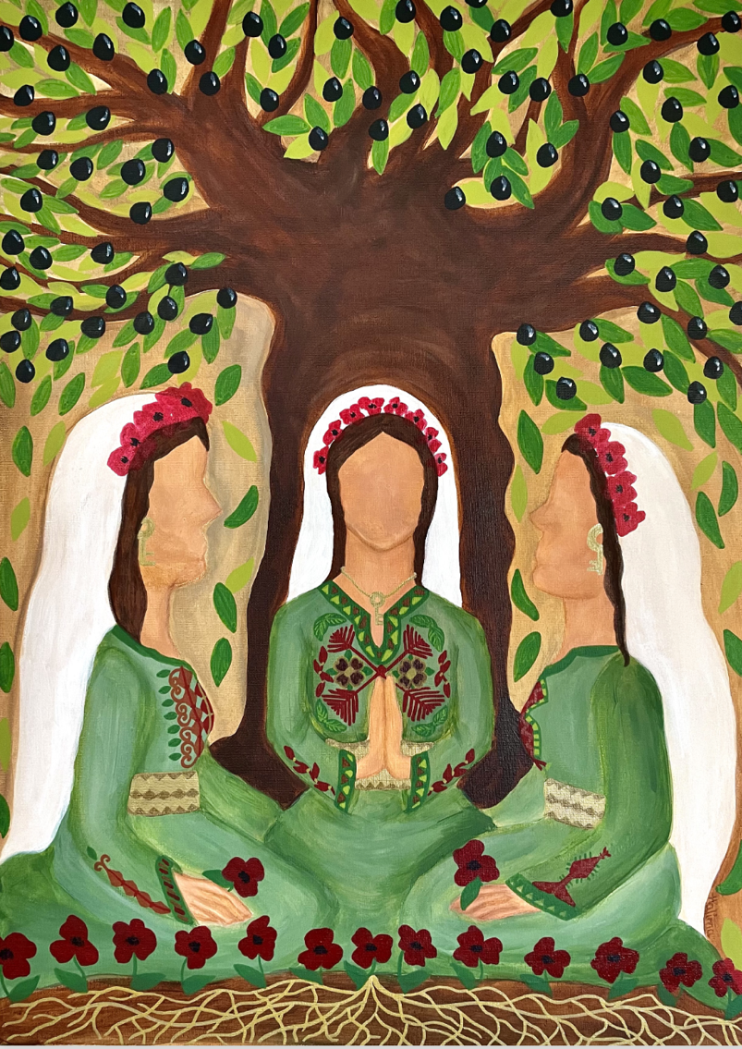
WORLD DAY OF PRAYER 2024
WRITTEN BY THE WOMEN OF PALESTINE
"I Beg You… Bear With One Another in Love” Ephesians 4:1-3

Slide 2
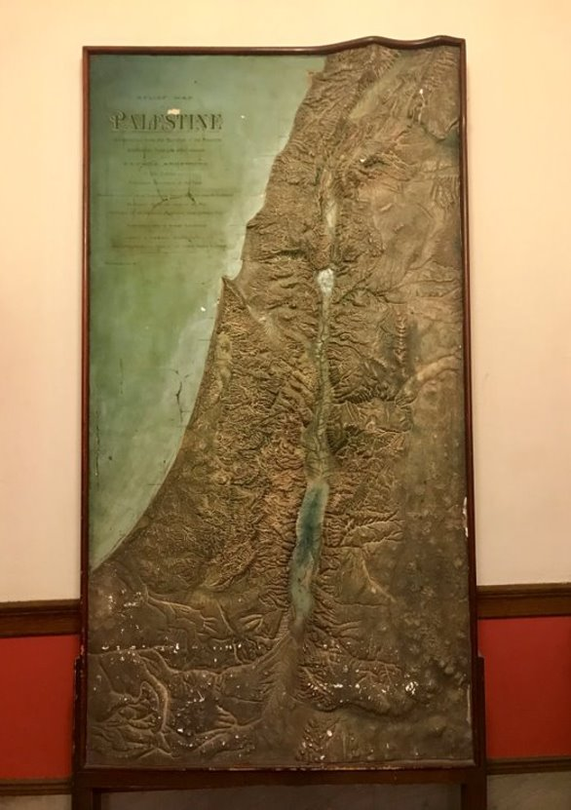
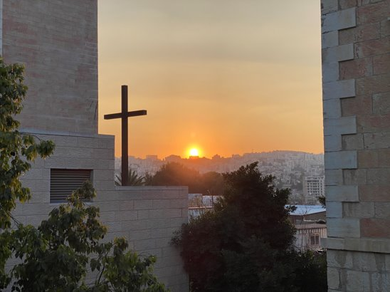
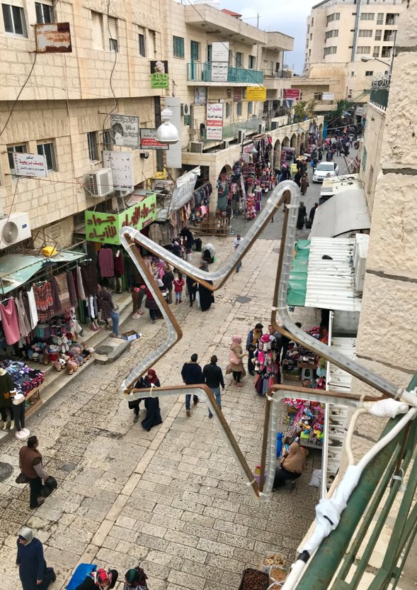
Background
Historic map of Palestine from 1893
Sunset in Bethlehem
A street in Bethlehem

Slide 3
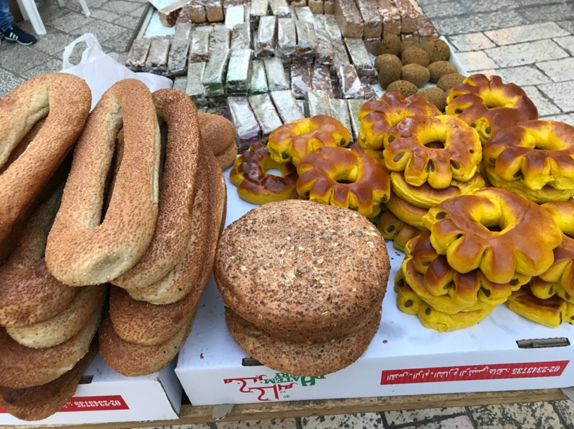
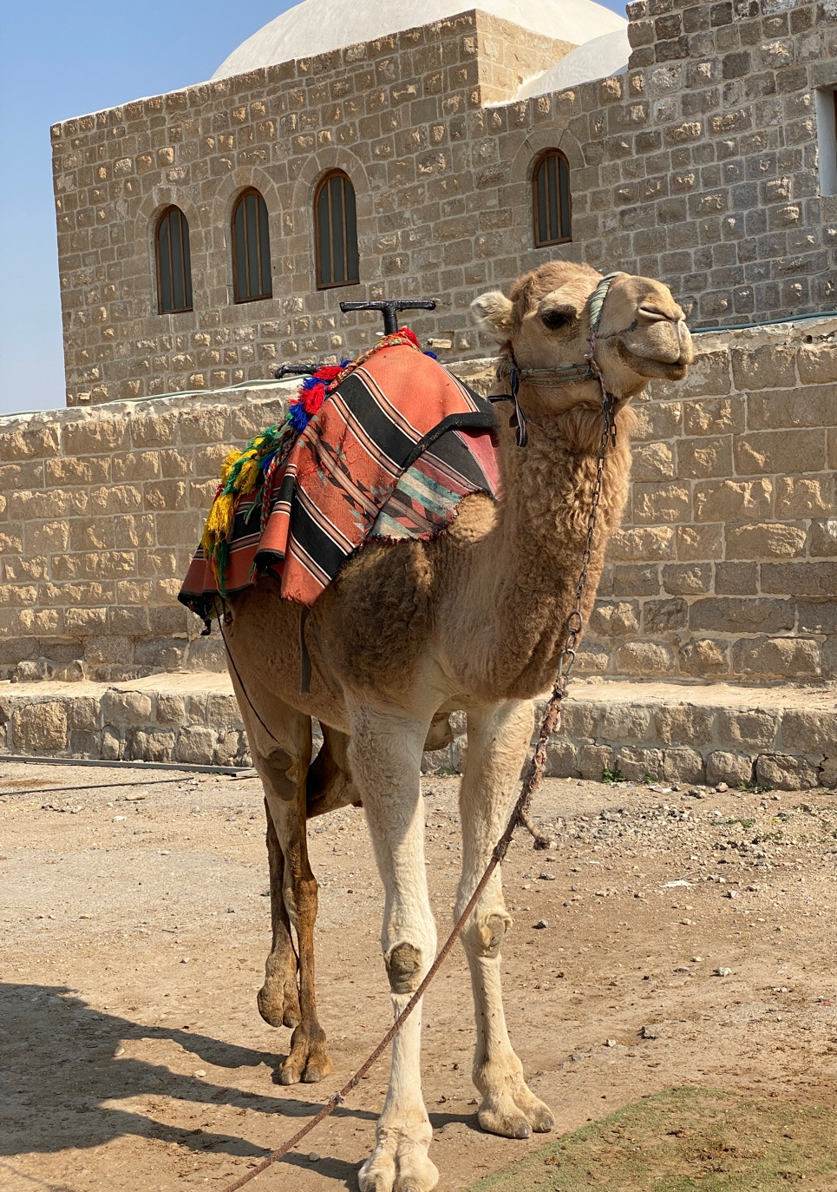
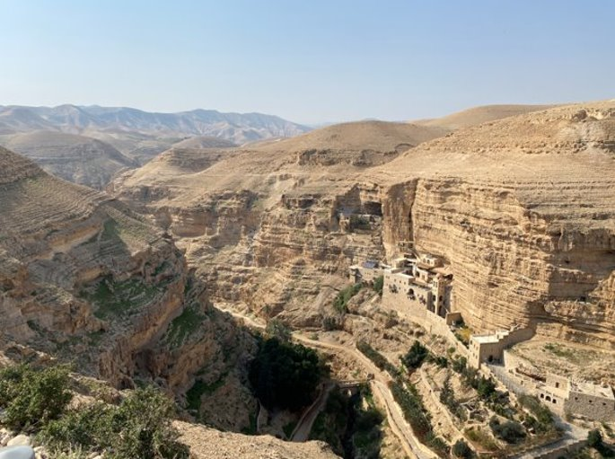
St. George’s Monastery (Greek Orthodox)

Slide 4
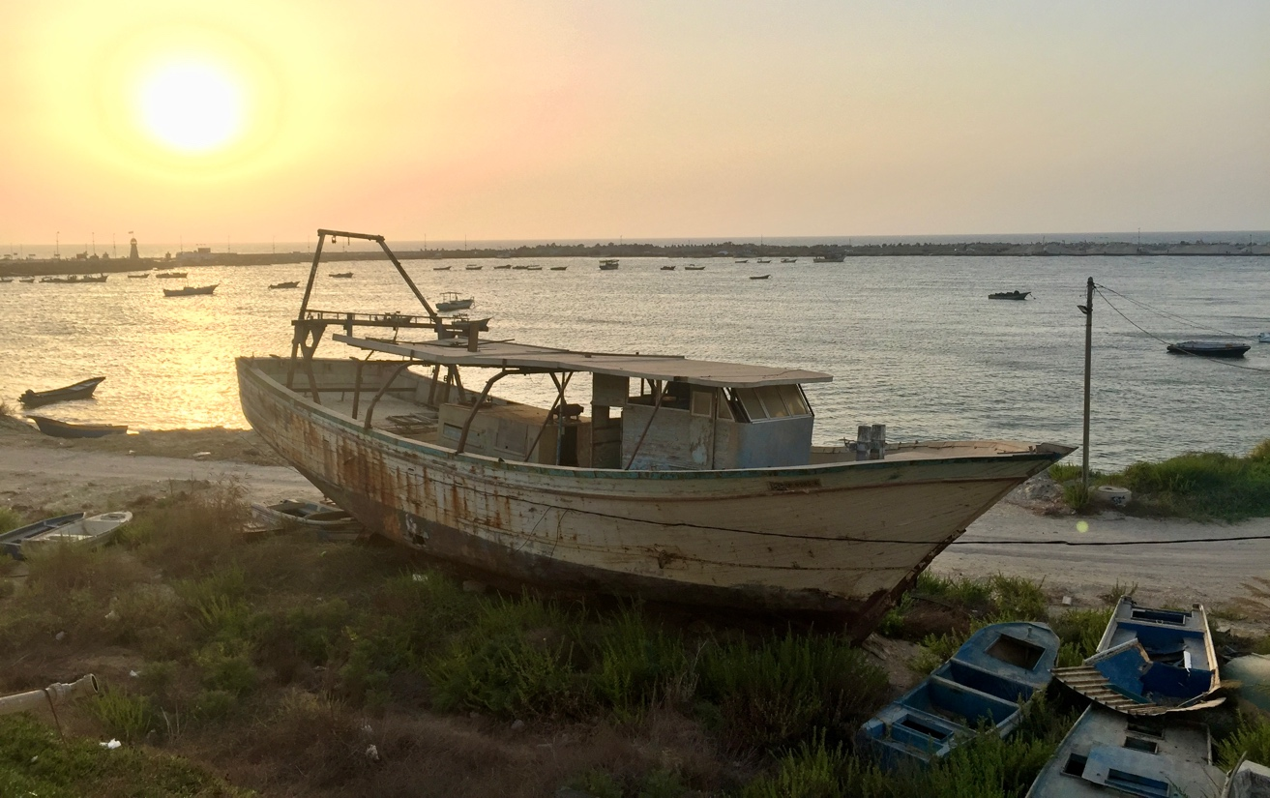
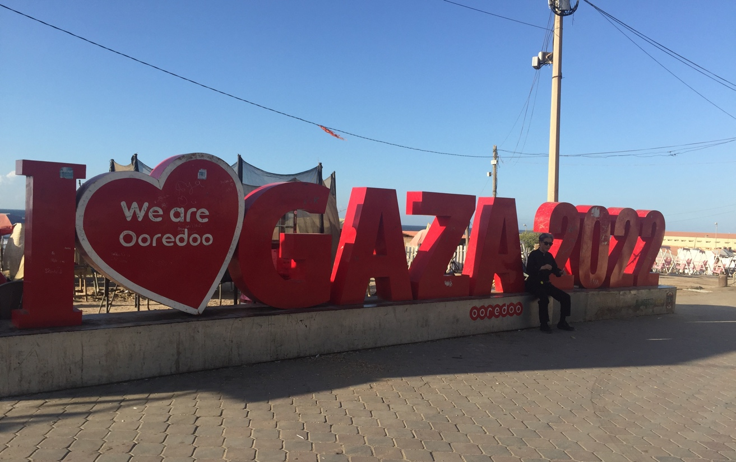
Geographical Location
Port of Gaza City © David Wildman
Beach of Gaza City © David Wildman

Slide 5
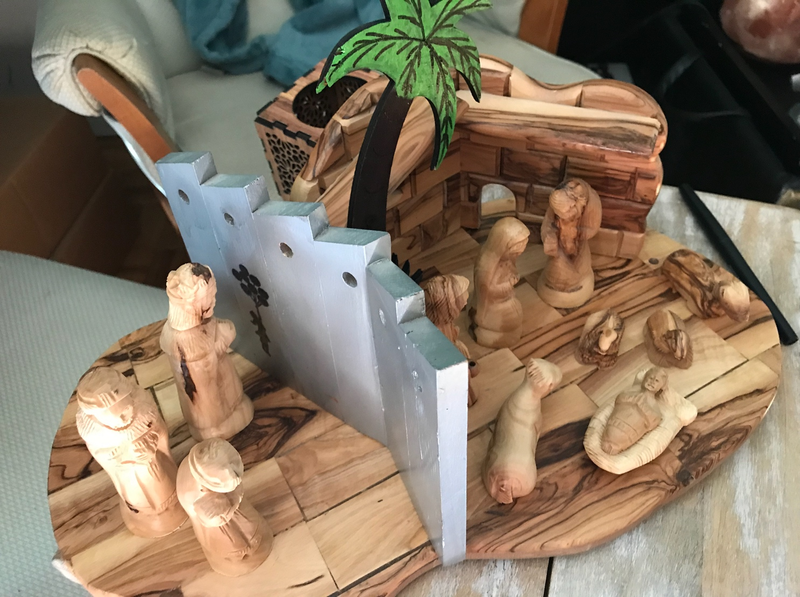
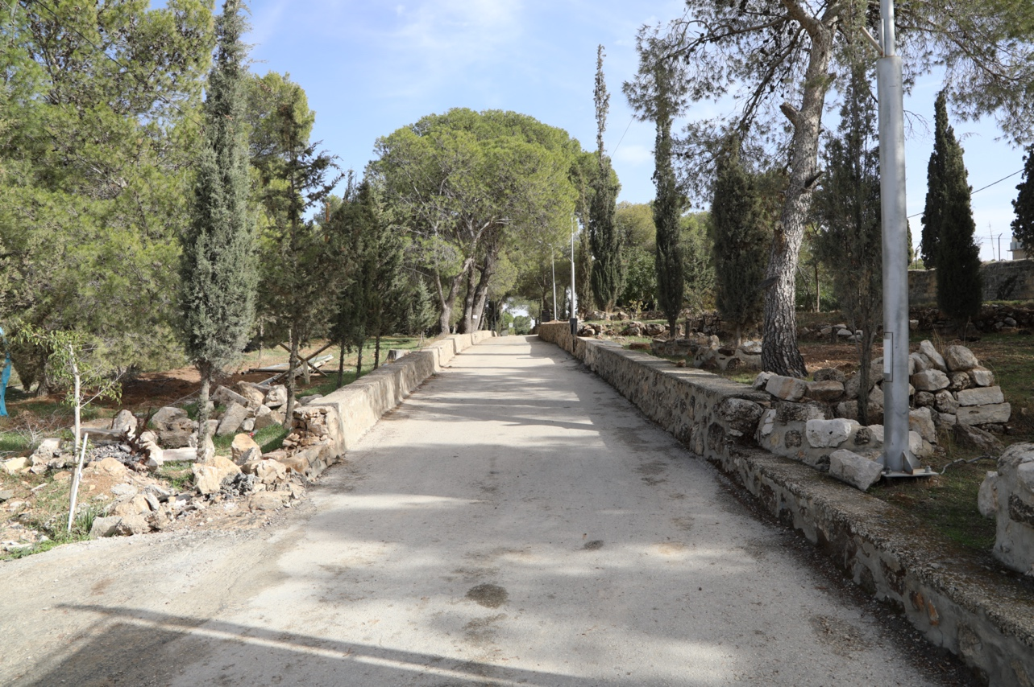
© Nidal Atrash
Olivewood nativity set with the Separation Wall in Bethlehem

Slide 6
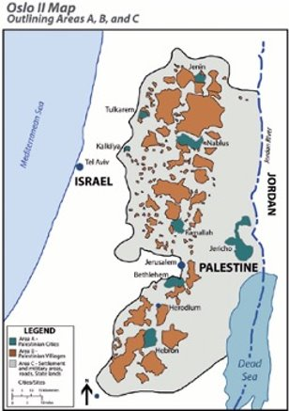
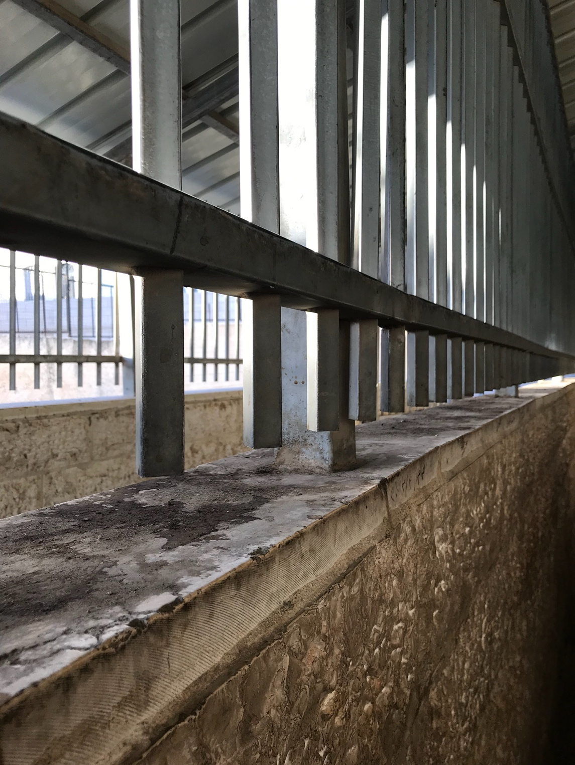
Areas A, B, and C in the West Bank
Checkpoint 300 between Bethlehem and Jerusalem

Slide 7
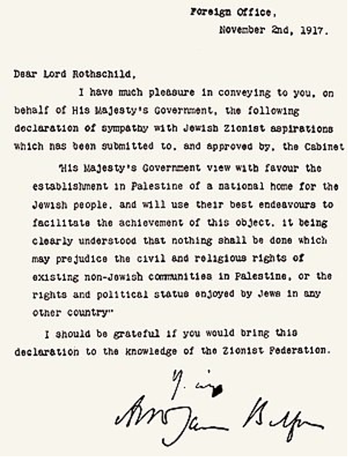
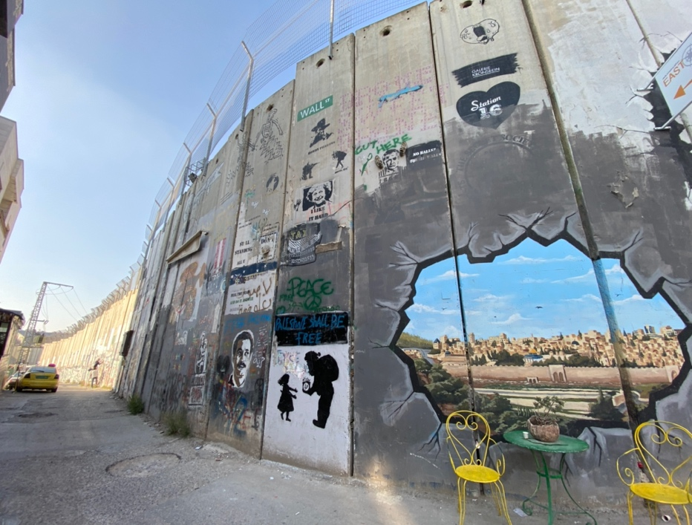
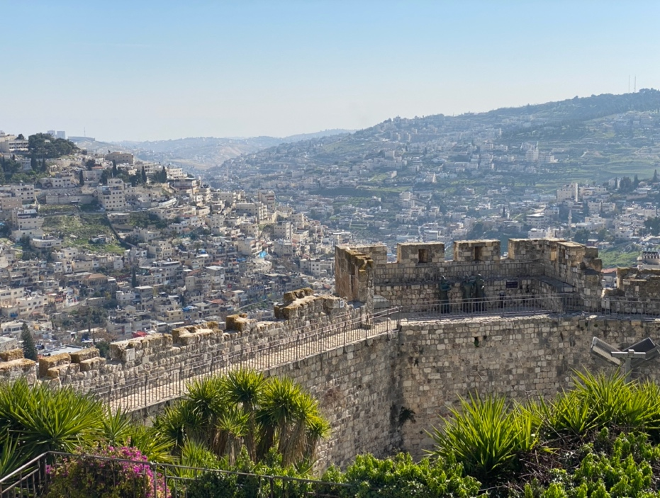
History
Jerusalem
The Separation Wall surrounding Bethlehem
Balfour Declaration of 1917

Slide 8
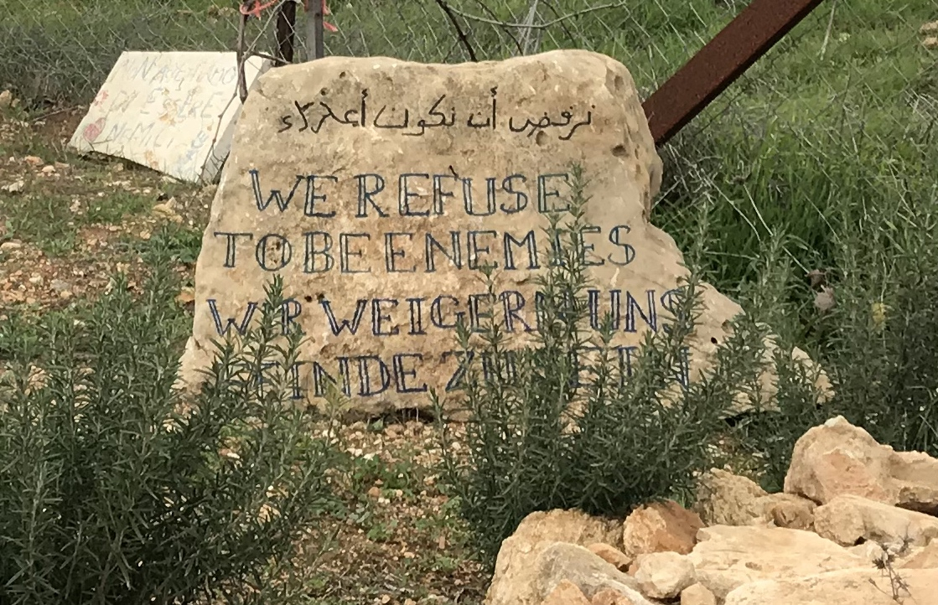
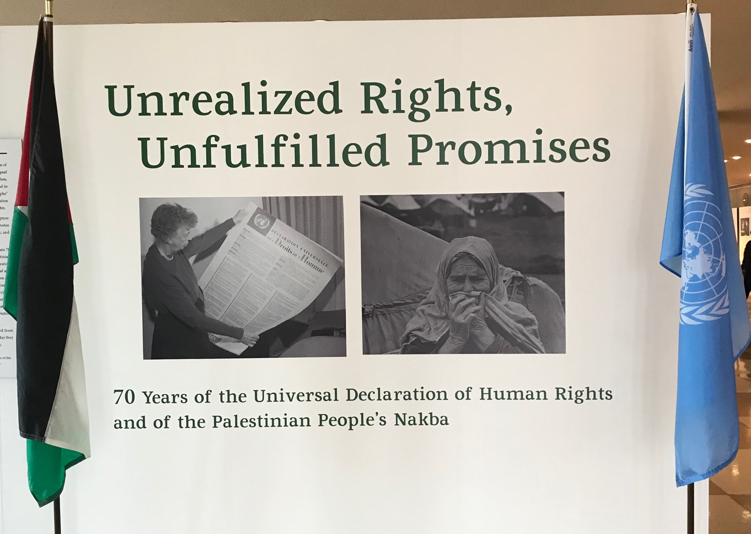
Display at the United Nations in 2018
“We Refuse to be Enemies” sign at the Tent of Nations

Slide 9
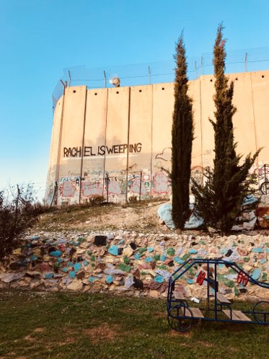
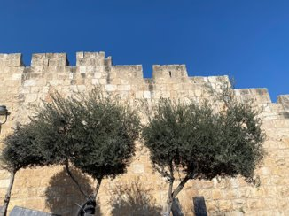
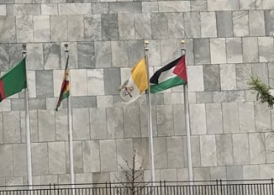
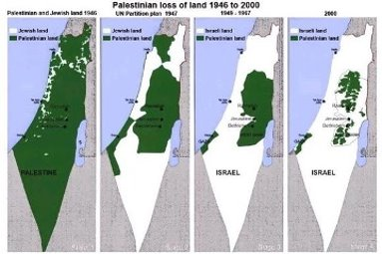
Jerusalem
Palestinian flag at the United Nations
Palestinians in the West Bank are cut off from Rachel’s Tomb by the Separation Wall
4 maps showing the loss of Palestinian land from 1946-2000

Slide 10
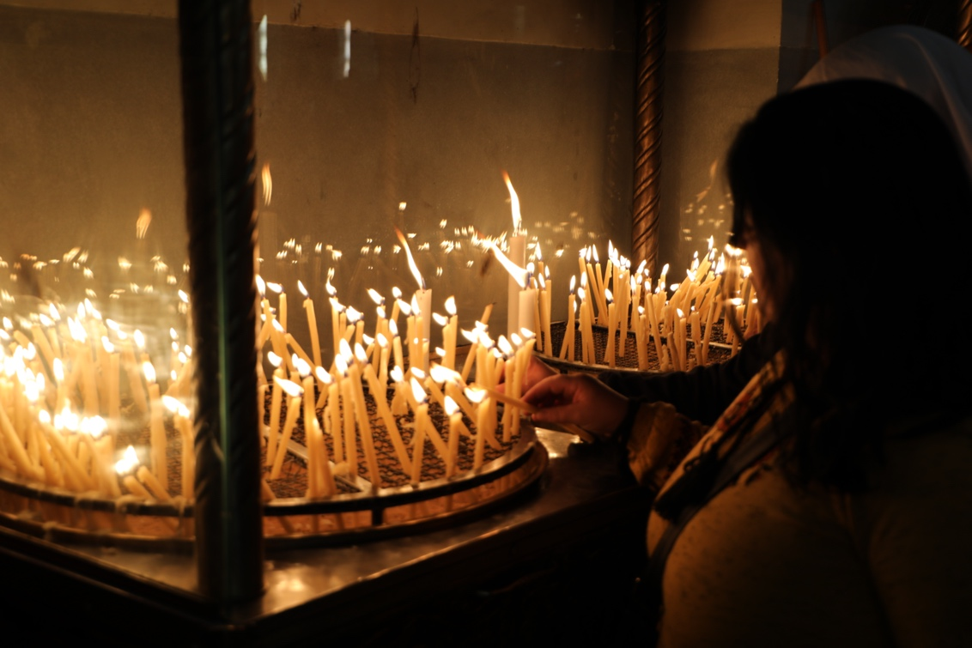
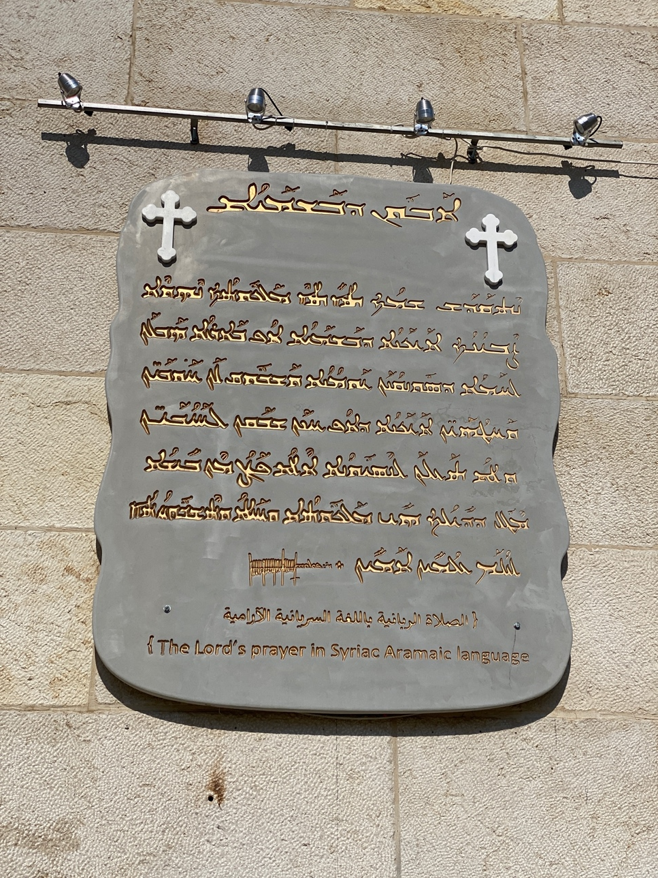
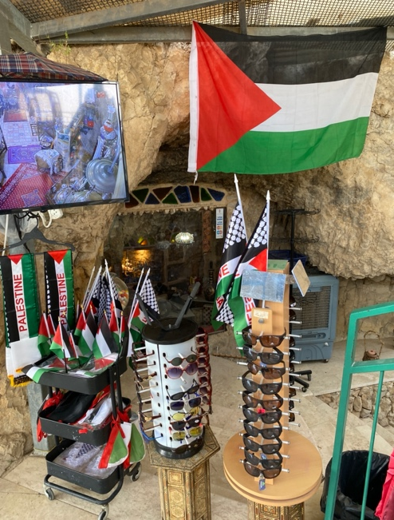
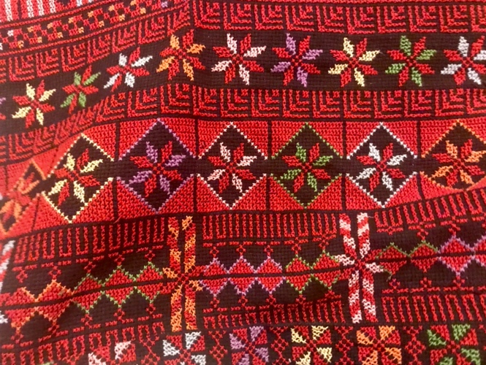
Population
© Nidal Atrash
The Lord’s Prayer in Aramaic, Bethlehem

Slide 11
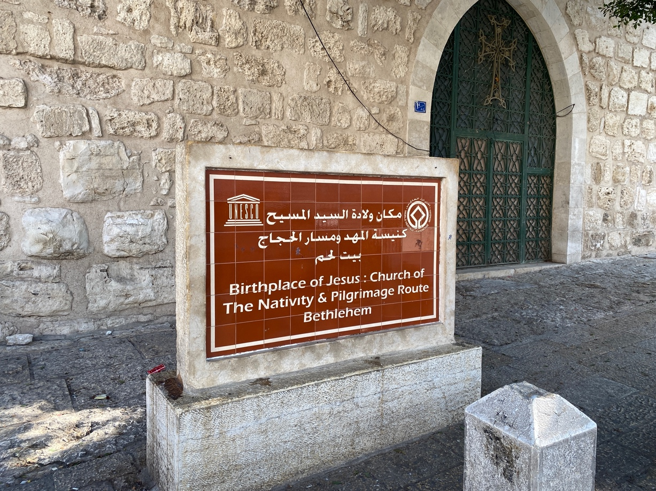
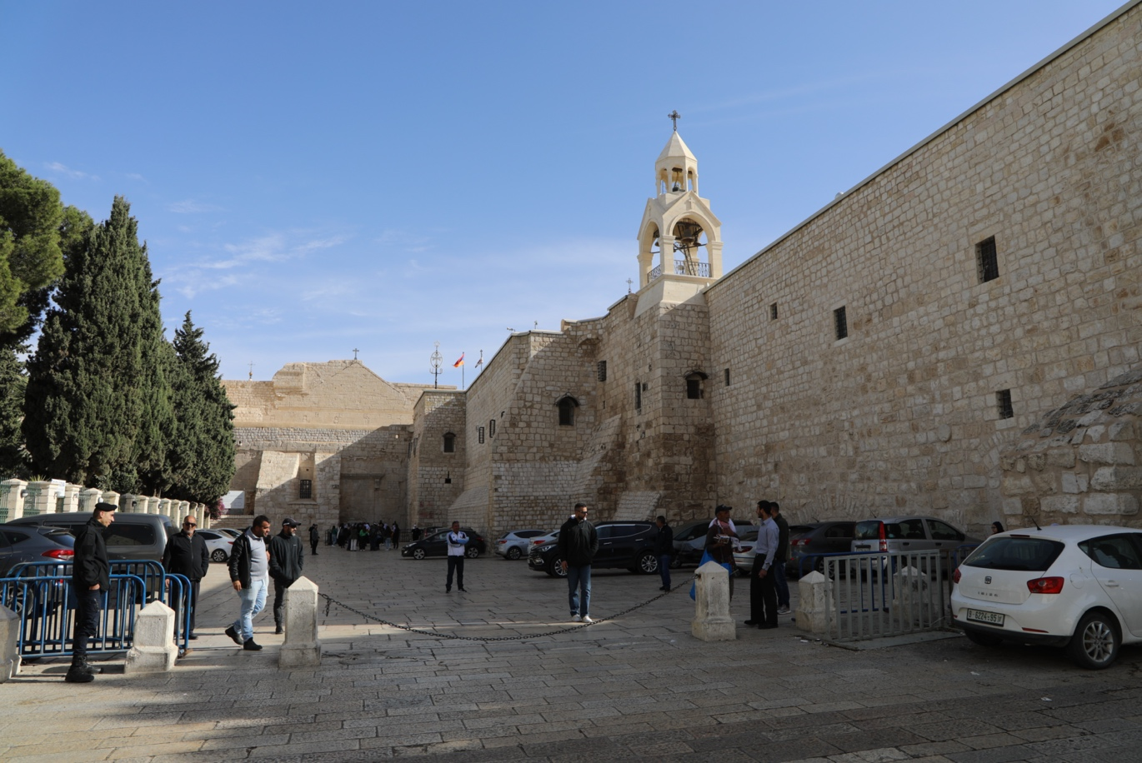
Biblical Sites
Church of the Nativity in Bethlehem
Church of the Nativity in Bethlehem © Nidal Atrash

Slide 12
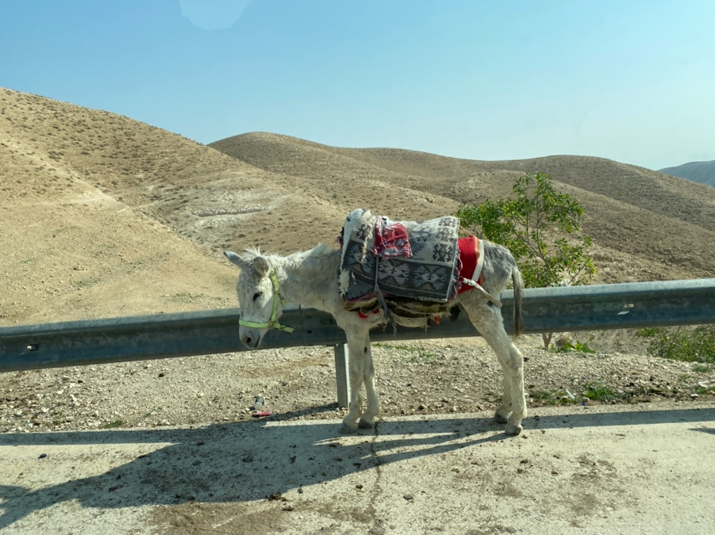
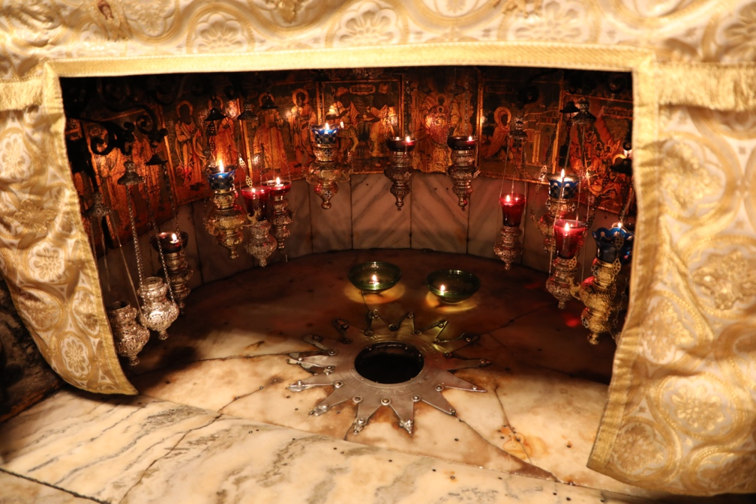
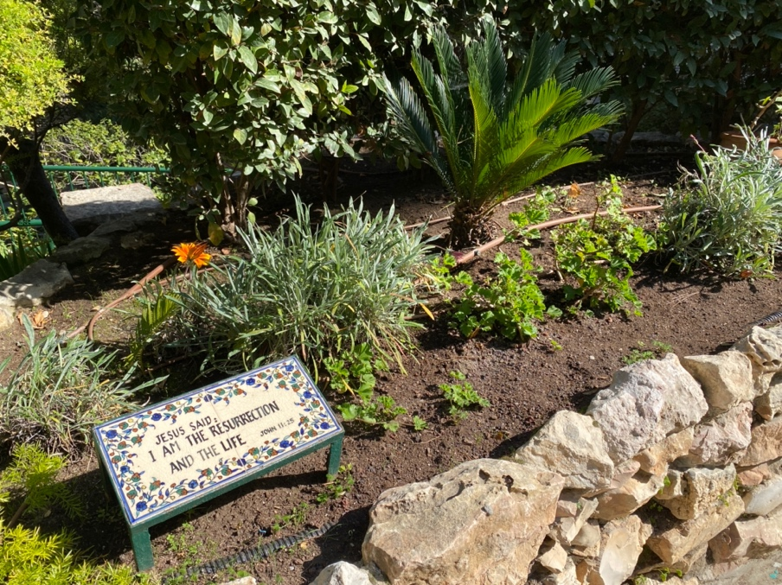
Donkey on the road to Jericho
Garden Tomb in Jerusalem
Church of the Nativity in Bethlehem
© Nidal Atrash

Slide 13
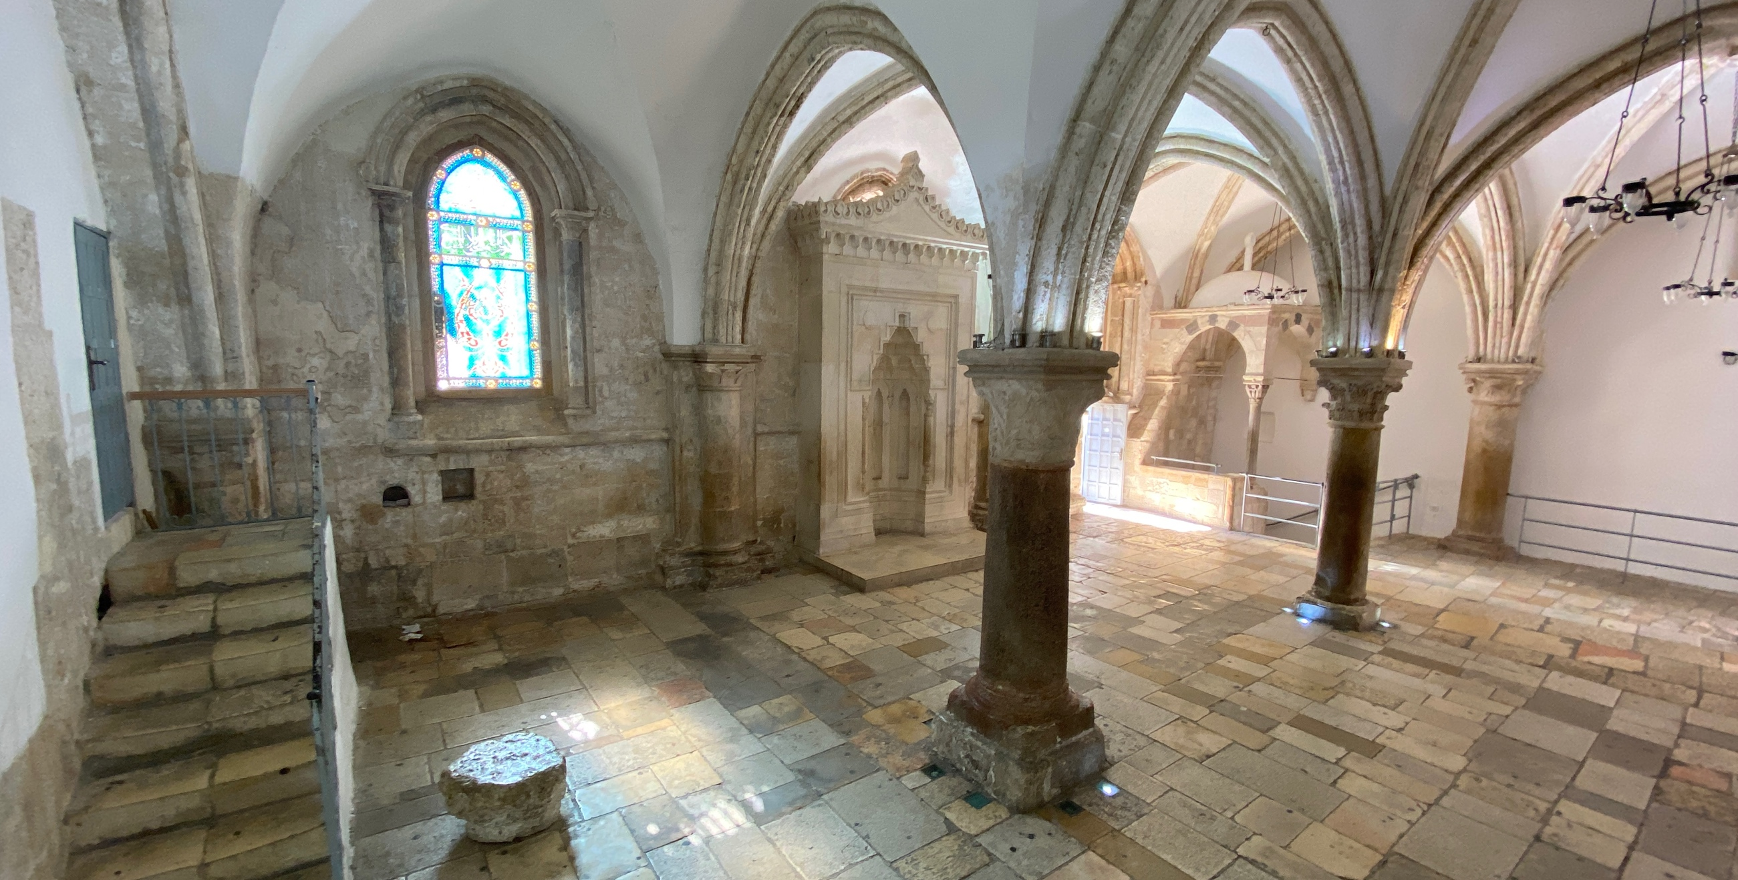
Room of the Last Supper, Jerusalem

Slide 14
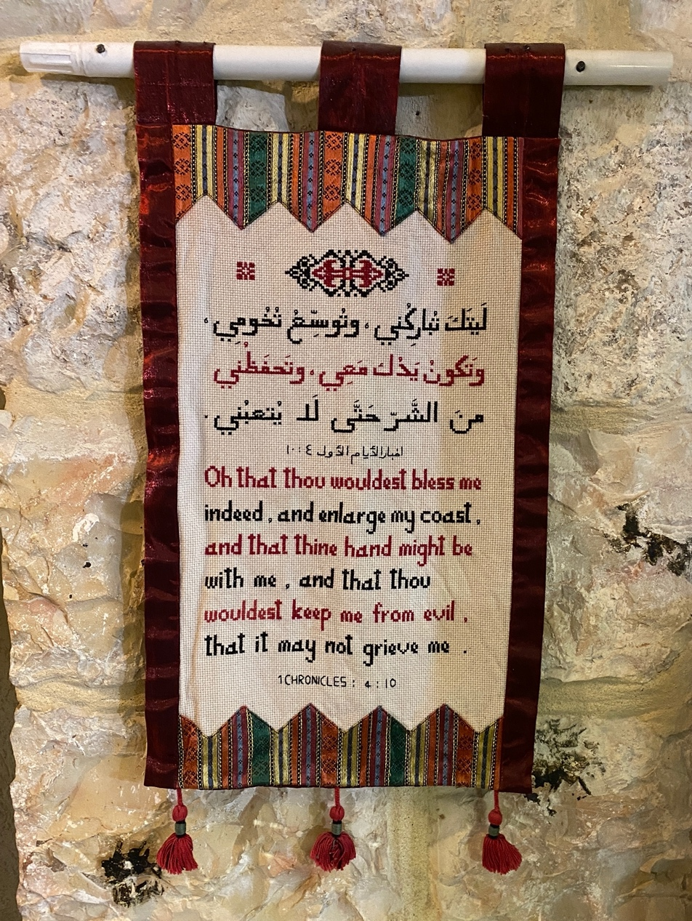
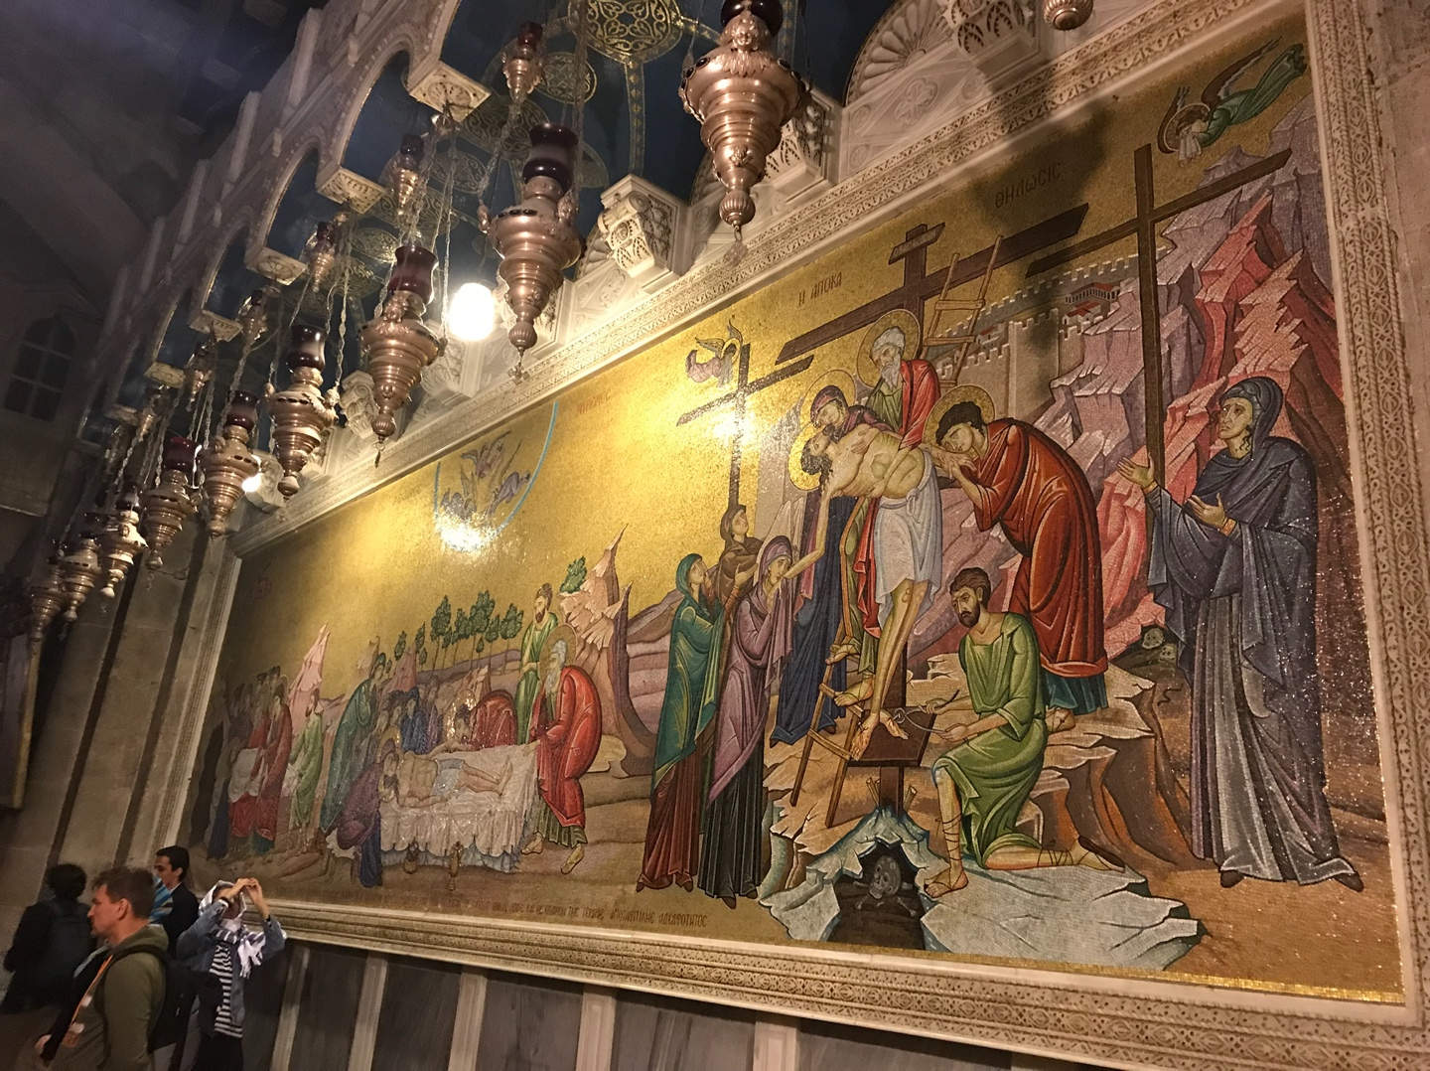
Christianity
Church of the Holy Sepulchre, Jerusalem
1 Chronicles 4:10 in Palestinian embroidery

Slide 15
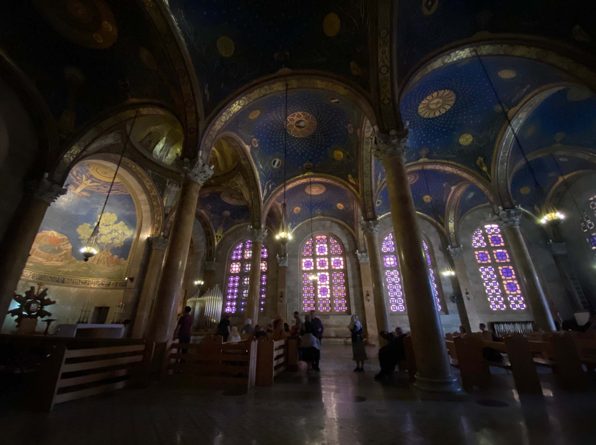
Church of All Nations at the Garden of Gethsemane, Jerusalem

Slide 16
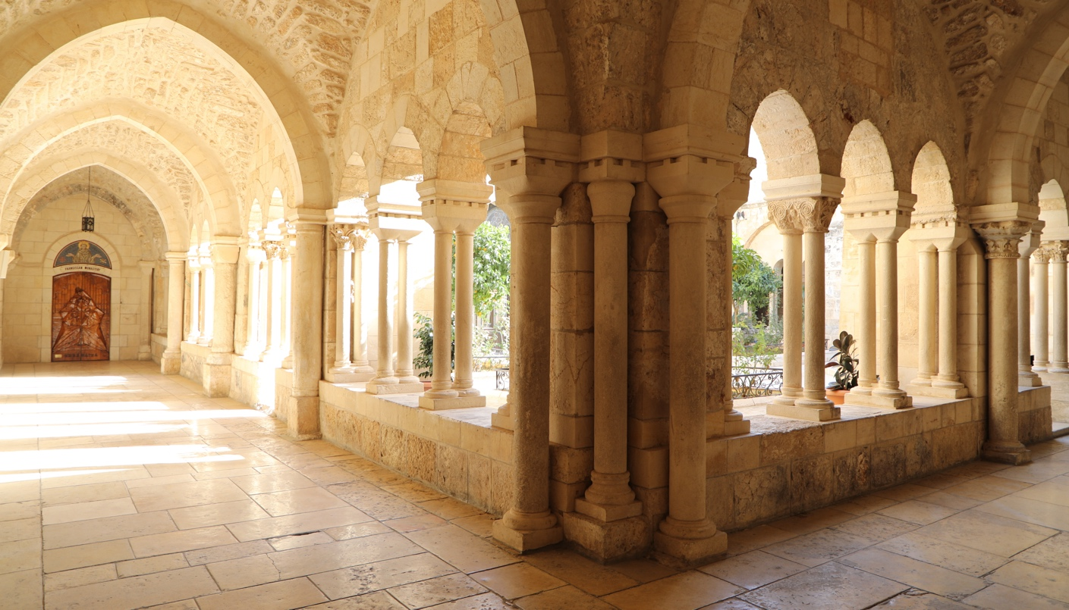
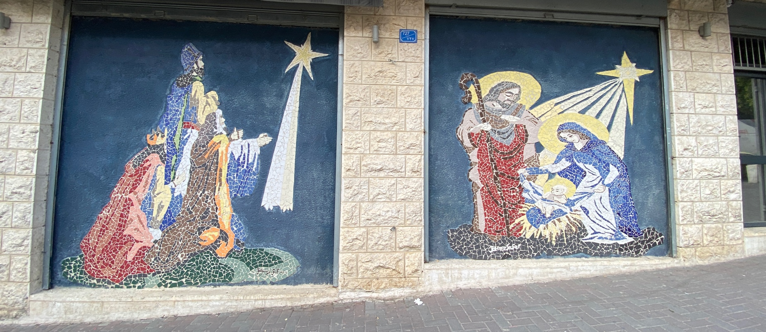
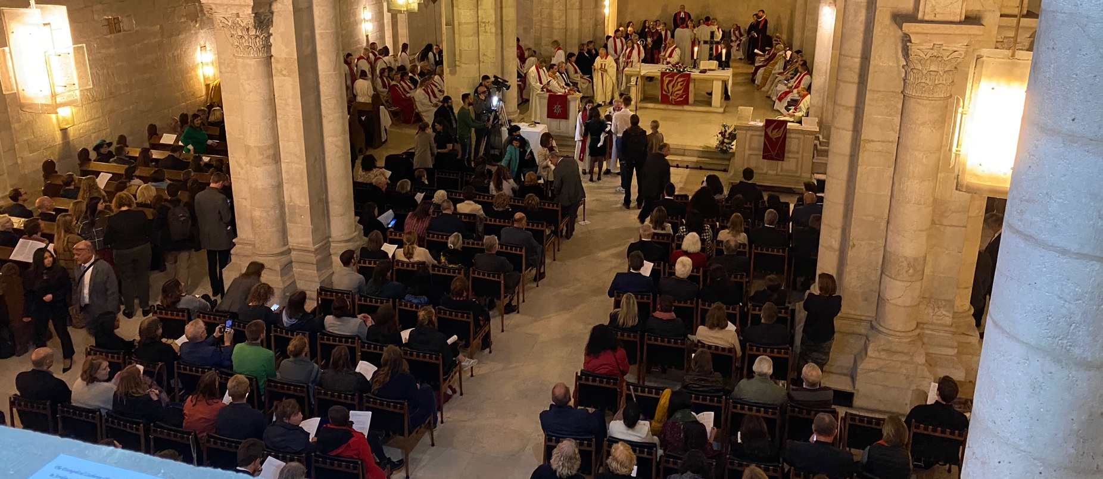
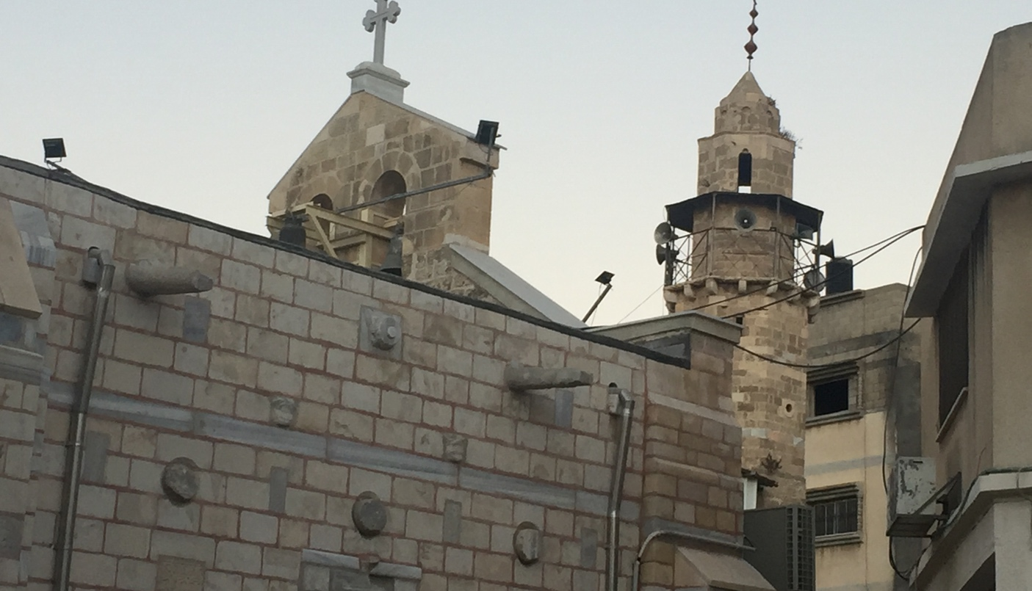
Nativity Church in Bethlehem© Nidal Atrash
Mural in Bethlehem
The Church of Saint Porphyrius Greek Orthodox Church in Gaza City
© David Wildman
Lutheran Church of the Redeemer in Jerusalem

Slide 17
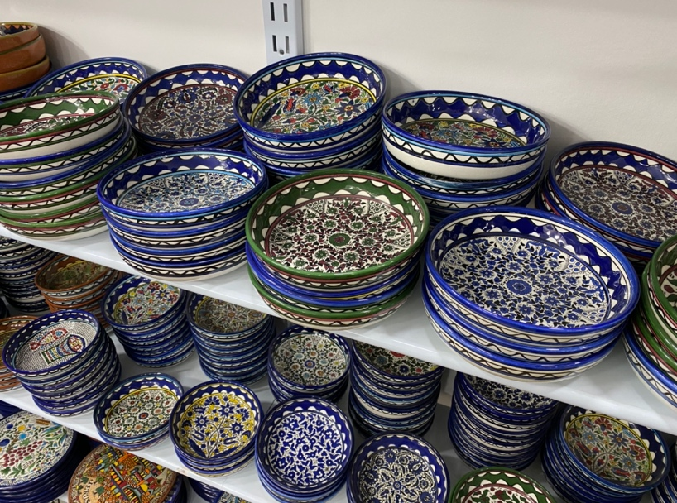
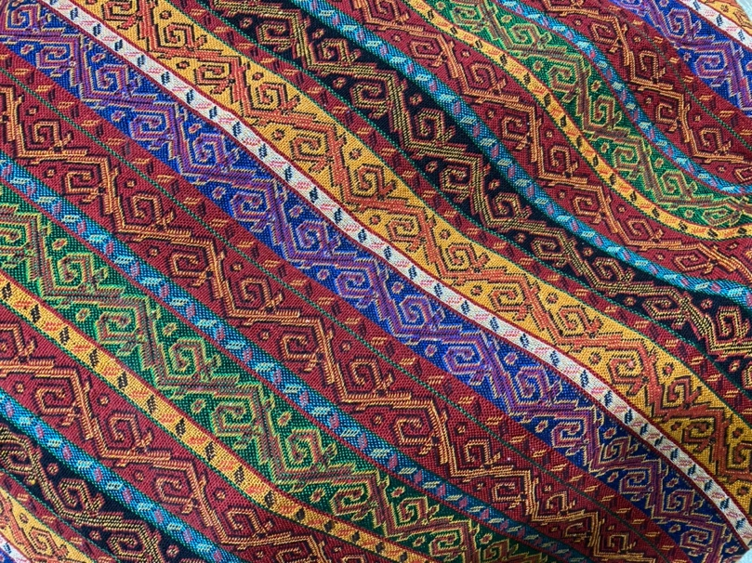
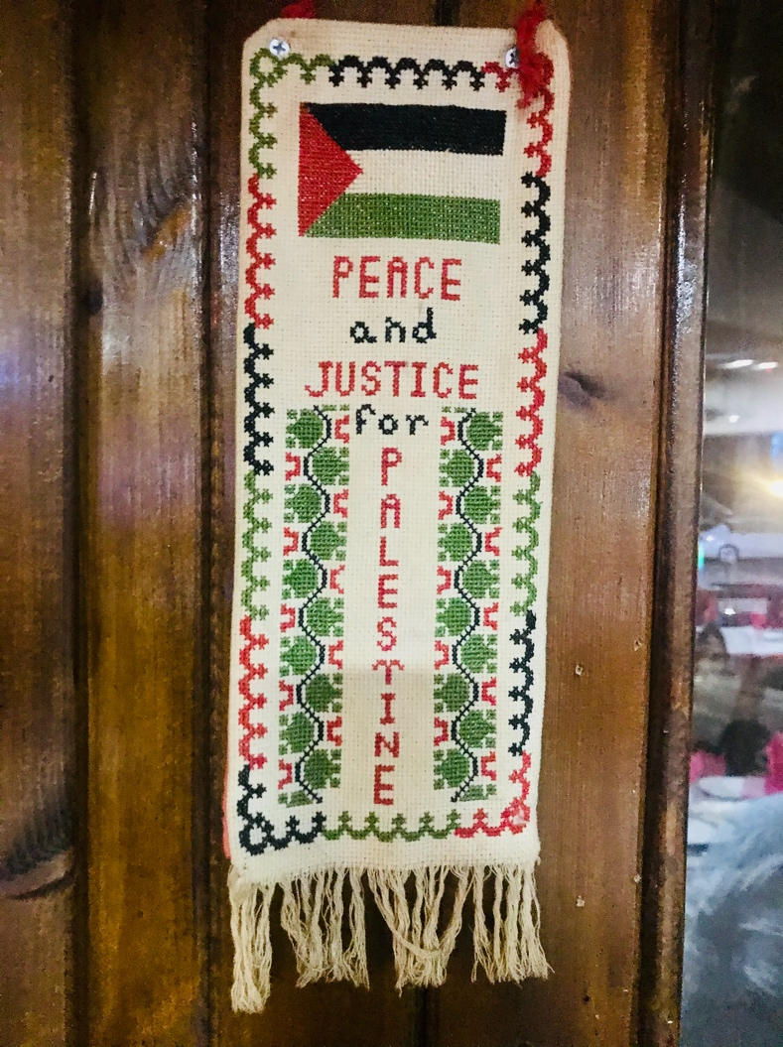
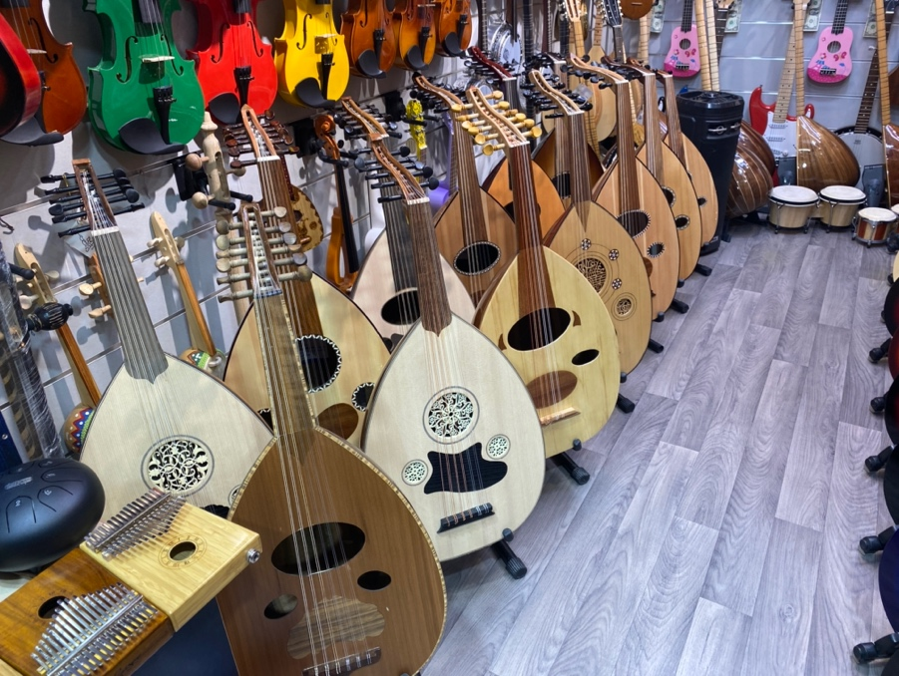
Culture
Handmade ceramics from Hebron
Fabric for sale in Jerusalem Old City
Palestinian embroidery
Oud instruments in Jerusalem’s Old City

Slide 18
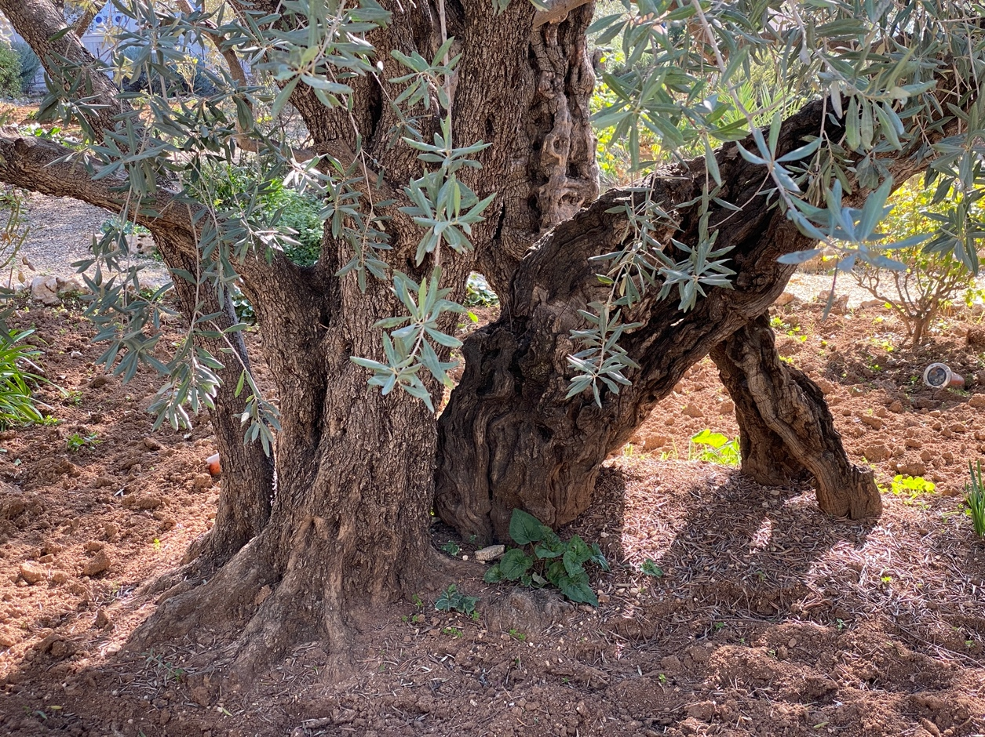
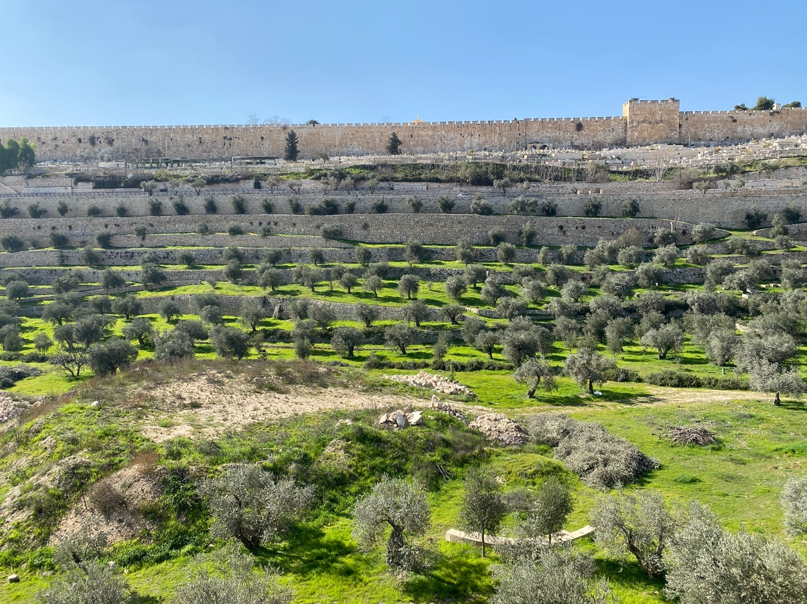
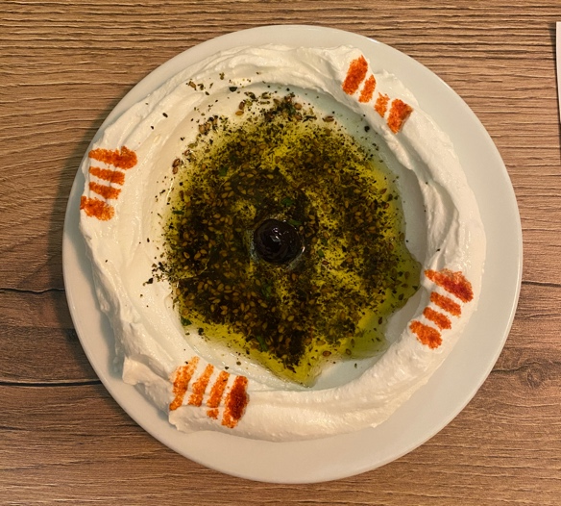
Agriculture
Olive tree in the garden of Gethsemane, Mount of Olives
Olive trees in Jerusalem
Olive oil with labneh

Slide 19
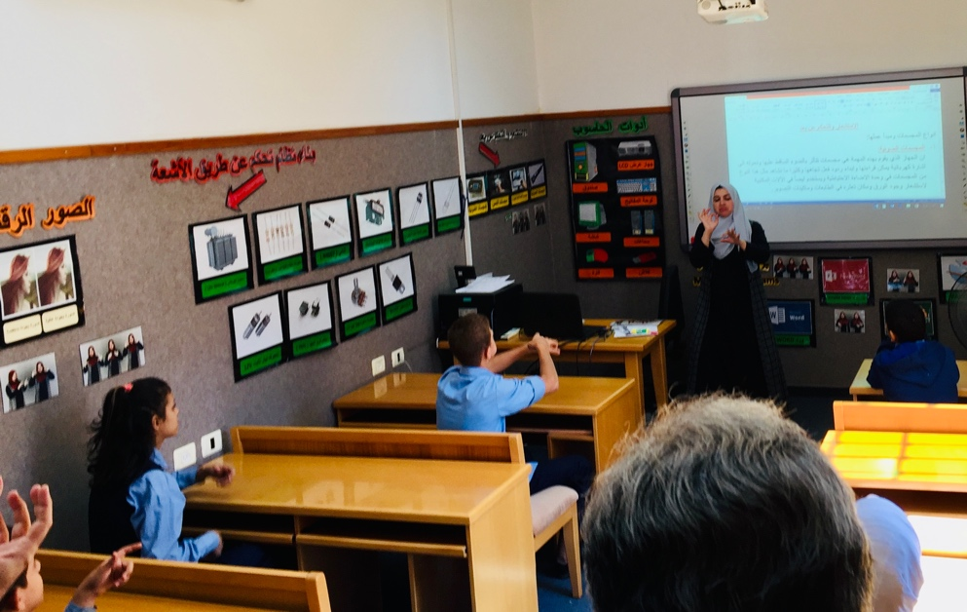
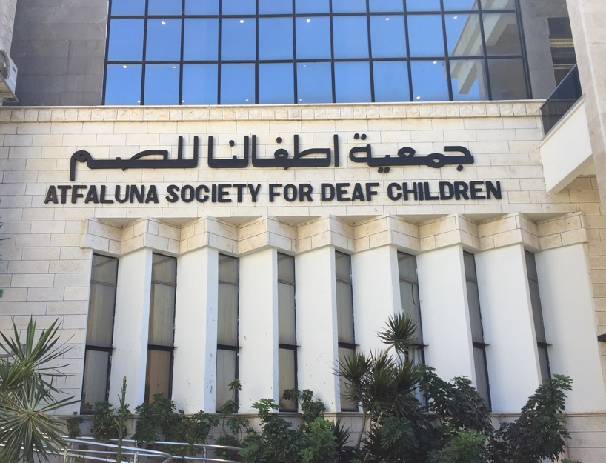
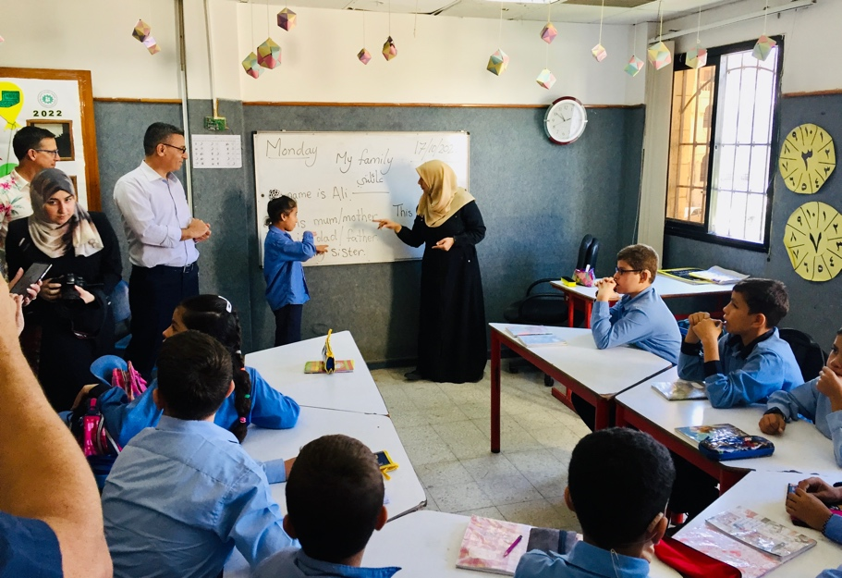
Education
Classroom in Gaza © David Wildman
Atfaluna Society for Deaf Children in Gaza
© David Wildman
Classroom in Gaza © David Wildman

Slide 20
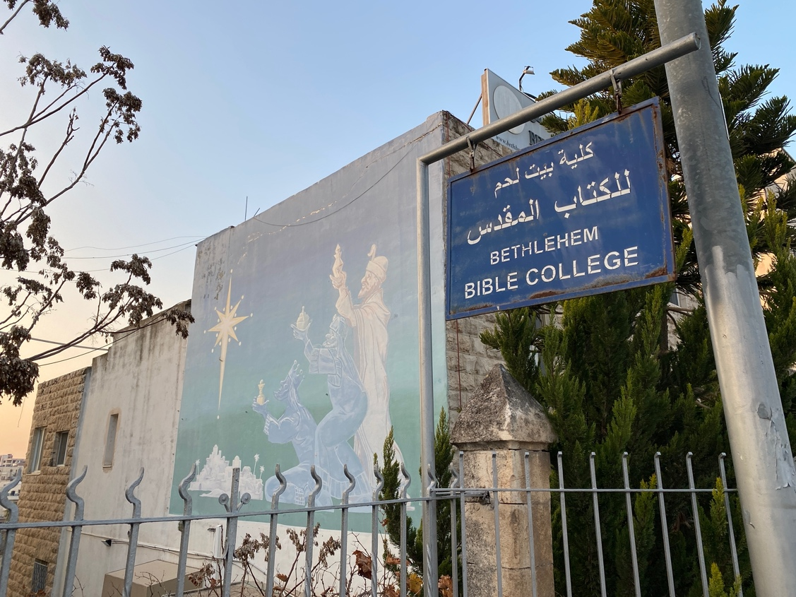
Bethlehem Bible College
Palestinian Scout Band
Image of children on Separation Wall surrounding Bethlehem

Slide 21
Women
UNRWA related Women’s Center in Gaza © David Wildman
Mural of Shireen Abu Akleh on Separation Wall surrounding Bethlehem
Mural at Tent of Nations

Slide 22
© Evangelical Lutheran Church in Jordan and the Holy Land (ELCJHL)
© Evangelical Lutheran Church in Jordan and the Holy Land (ELCJHL)

Slide 23
Sketches of women at the Women’s Programme Center in Gaza
© David Wildman
Rose in Jerusalem

Slide 24
World Day of Prayer
Women from WDP Palestine
1994 WDP Palestine Artwork

Slide 25
Art & Artist
Halima Aziz

