Slide 1
Welcome

Slide 2
“Sing Praise and Thanksgiving” With One Voice no.25
Words by Paul Gerhardt translated and adapted by M Barclay and C A Gibson.
Used with permission

Slide 3
Sing praise and thanksgiving,
let all creatures living
now worship their maker
with gladness and song;
all glory and honour
we come to him bringing:
O praise to the Almighty,
sing praise to our God!
Words by Paul Gerhardt translated and adapted by M Barclay and C A Gibson. Used with permission

Slide 5
Welcome and Greetings

Slide 6
“Ping-an.”
This phrase in Taiwanese means "May God grant you peace, a peaceful relationship with God and with one
another.”

Slide 7
Welcome!
On behalf of the sisters in Taiwan, we would like to welcome all of you to join us today in worship.

Slide 8
Dear sisters and brothers, through this celebration, we would like to share our experiences with you, and witness God’
wonderful grace and mighty works.

Slide 10
“Love is Your Way” (God in Your Grace) Hope is our Song No.95
The NZ Hymnbook Trust. Music Per Harling. © Words Shirley Erena Murray. Used with permission

Slide 11
Love is your way,
love is your nature,
blessing each creature,
lighting each day;
grace is your sign,
gift of forgiveness,
chalice that changes
water to wine
The NZ Hymnbook Trust. Music Per Harling. © Words Shirley Erena Murray. Used with permission

Slide 12
God, in your grace,
God in your mercy,
turn us to you to transform the world!
turn us to you to transform the world!
The NZ Hymnbook Trust. Music Per Harling. © Words Shirley Erena Murray. Used with permission

Slide 13
Let us stand still,
look at each other,
sister and brother
thwarting your will:
teach us good care,
grace to seek pardon,
reclaim your garden,
riches to share
The NZ Hymnbook Trust. Music Per Harling. © Words Shirley Erena Murray. Used with permission

Slide 14
God, in your grace,
God in your mercy,
turn us to you to transform the world!
turn us to you to transform the world!
The NZ Hymnbook Trust. Music Per Harling. © Words Shirley Erena Murray. Used with permission

Slide 16
Call to Worship

Slide 17
Praise to the Lord, we thank God for all the blessings bestowed upon Taiwan.
Praise God, the Creator, who created this beautiful island covered with mountain forests and nurtured by the ocean.
Taiwan is rich in natural resources.
All: Let the name of the Lord be praised.
May your glory be with us.

Slide 18
More than one hundred years ago, missionaries who came
to Taiwan spread the good news.
The people heard the gospel and received the grace of salvation.
All: Let the name of the Lord be praised.
May your glory be with us.

Slide 19
Since the 16th century, Taiwan has been colonized by different foreign forces and experienced ethnic, cultural, social, political conflict and integration.
By the Grace of God, the people on this island can live in peace.

Slide 20
Taiwan shows great hospitality and is willing to help and become a blessing to others.
All: Gracious God, we thank you and praise you.
May your glory be with us.

Slide 22
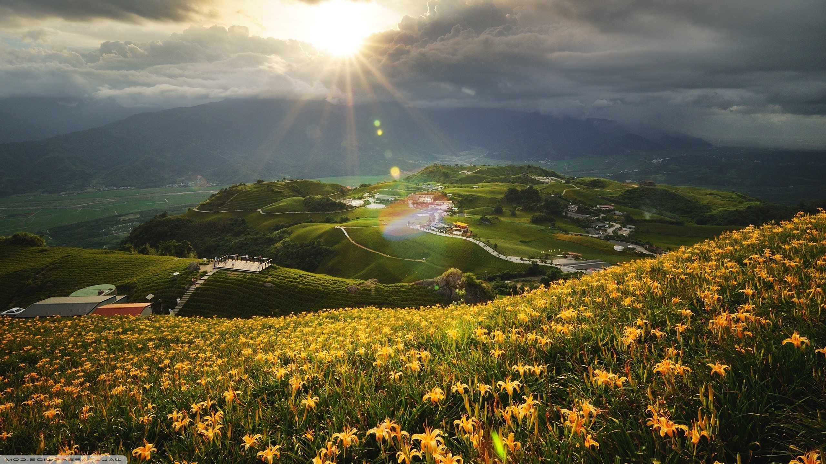
“Simply to Be” Hope is Our Song No.118
The NZ Hymnbook Trust © Words Shirley Erena Murray, Music Colin Gibson. Used with permission

Slide 23
Simply to be, to be in stillness,
simply to trust that God is here,
simply to know the Holy Presence
is to be blessed;
so am I blessed.
The NZ Hymnbook Trust © Words Shirley Erena Murray, Music Colin Gibson. Used with permission

Slide 25
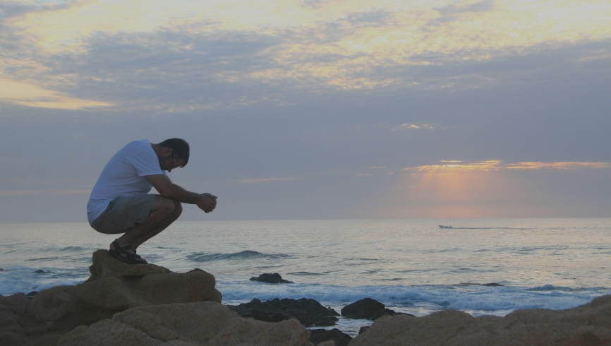
Prayer of Confession

Slide 26
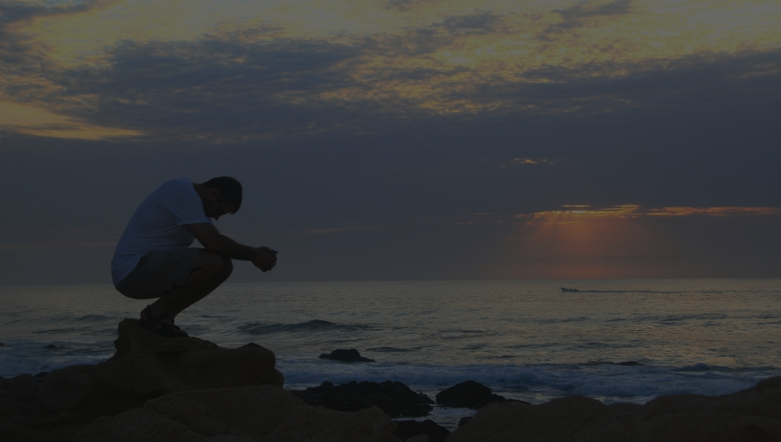
Forgiving God, we confess our sins to you.
We sin against you.
We have failed to take care of the land you entrusted to us and have used it in unrighteous ways causing pollution and the extinction of various species.
All: Oh Lord, have mercy on us.

Slide 27
Gracious God, we are selfish and arrogant.
We have overlooked human dignity; we ignore the needs of minorities, migrants, and immigrants. We hear the cries of the land, women, children, and young people, but we have not done enough to respond to the grace that we received.

Slide 28
These actions have caused some people to suffer and be oppressed.
All: Oh Lord, have mercy on us.

Slide 30
“Simply to Be” Hope is Our Song No.118
The NZ Hymnbook Trust © Words Shirley Erena Murray, Music Colin Gibson. Used with permission

Slide 31
Simply to hold the given moment,
simply to lay concern aside,
simply to let the heart be speaking,
is to be blessed;
so am I blessed.
The NZ Hymnbook Trust © Words Shirley Erena Murray, Music Colin Gibson. Used with permission

Slide 33
Assurance of Pardon

Slide 34
O God, you are faithful and righteous.
May you forgive us, cleanse away our sins, and help us live in the light.
May you give us a spirit of wisdom and revelation as we come to know you and be filled with love and faith.

Slide 35
May you reveal yourself to us so that we may know the immeasurable greatness of your power.
All: Amen

Slide 37
“Simply to Be” Hope is Our Song No.118
The NZ Hymnbook Trust © Words Shirley Erena Murray, Music Colin Gibson. Used with permission

Slide 38
So am I blessed within God’s keeping,
so am I freed from pointless stress,
steadied to feel the soul replenished,
given this grace,
folded in peace.
The NZ Hymnbook Trust © Words Shirley Erena Murray, Music Colin Gibson. Used with permission

Slide 40
The Word of God and the Witnesses of Life

Slide 41
Scripture Reading Ephesians 1:15-19 New Revised Standard Version

Slide 42
I have heard of your faith in the Lord Jesus and your love toward all the saints, and for this reason I do not cease to give thanks for you as I remember you in my prayers.

Slide 43
I pray that the God of our Lord Jesus Christ, the Father of glory, may give you a spirit of wisdom and revelation as you come to know him, so that, with the eyes of your heart enlightened, you may know what is the hope to which he has
called you,

Slide 44
what are the riches of his glorious inheritance among the saints, and what is the immeasurable greatness of his power for us who believe, according to the working of his great power.

Slide 46
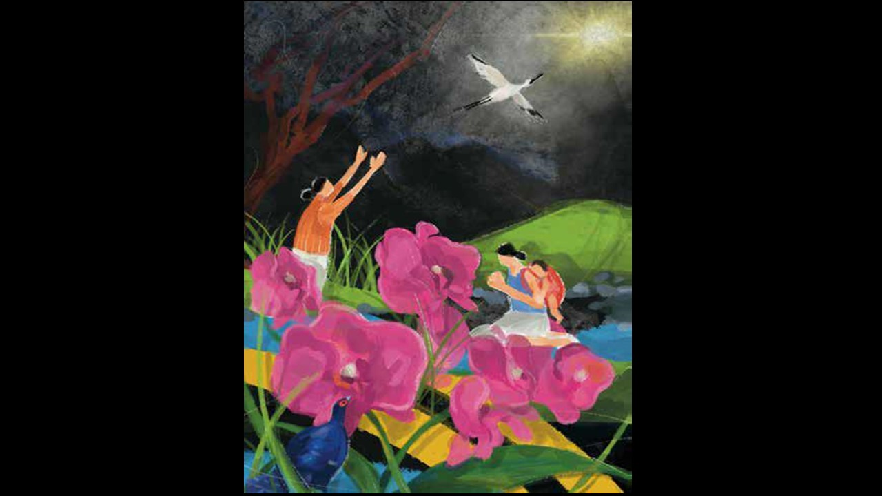
The Word of God and the Witnesses of Life Meditation

Slide 48
Paul gave thanks to God for the Ephesians living out their love and faith. He prayed that they would receive a spirit of wisdom
and revelation and would “come to know [God]” through the light and inspiration of the Holy Spirit!

Slide 49
Oftentimes we are frustrated by difficulties and obstacles and may even lose our hope and faith, or rely on our weak human nature.

Slide 50
However, we are called to keep our “hope and faith” in God's kingdom and promises. Through the enlightenment of the Holy Spirit, we come to see the faithful, loving, and gracious God.

Slide 51
Throughout the letter, the author shared his prayers for the saints in the trust that they could grasp how wide and long and high and deep the love of Christ is (Ephesians 3:18). Should we be willing to respond to that love by living not for ourselves but for God?

Slide 52
The love of Christ may be revealed through our actions, which will point to God’s glorious and abundant inheritance!

Slide 53
In the eyes of God, we are not pieces of confetti that go with the wind without a specific direction, but irreplaceable pieces of a puzzle. Despite our different social backgrounds, regional contexts, and diverse cultures, we come to unity in Jesus Christ.

Slide 54
Silence for meditation.

Slide 55
We have heard the faith stories of women and girls in Taiwan, and we are sending them a letter of encouragement.
Let us hear the letters.

Slide 57
The Word of God and the Witnesses of Life Woman 1 Dear Sister Pao-Chu…

Slide 58
Last time we met at the gathering I heard your stories about the urgency of protecting the environment. Your story of faith impacted me, and I have followed in your footsteps ever since. I have recycled resources, joined a beach cleaning, and sorted waste at home. I carry my own cutlery and cup to mitigate the plastic crisis.

Slide 59
Most importantly, I teach our next generations to protect the environment.
We hope that Taiwan can be a nuclear-free homeland in the future.
Let us learn together to become good stewards of God’

Slide 60
Silence

Slide 61
Responsive Hymn “I have heard about your faith”
Words: Ephesians 1:15-16, Music: Lai, Yin-ting. Composed especially for the 2023 WDP Taiwan programme. © WDPIC. Used with permission.

Slide 62
"I have heard about your faith
in the Lord Jesus Christ,
I have heard about your love
toward all the saints.
I have not stopped
giving thanks for you,
and remembering you in my prayers.”
Words: Ephesians 1:15-16, Music: Lai, Yin-ting. Composed especially for the 2023 WDP Taiwan programme. © WDPIC. Used with permission.

Slide 64
The Word of God and the Witnesses of Life Woman 2 Dear Sister Fen-Jiau…

Slide 65
I have heard of your faith. You, a middle-aged, indigenous woman, have become a wonderful blessing to women of a similar age.

Slide 66
As a homemaker, you have dedicated yourself to your family for decades. When you tried to find a job to support your family, you were challenged at the workplace. You faced discrimination because of your age and felt pressured to accept social rules against women.

Slide 67
You felt like you were neglecting your family responsibility, while taking care of your family was the reason you looked for a job. Facing a dilemma, you trusted God’s guidance and found the path to support your family by teaching traditional weaving and taking care of your tribe.

Slide 68
Your creative potential and strength thrived once again. Your testimony is a wonderful blessing that inspires many sisters.

Slide 69
Silence

Slide 70
Responsive Hymn “I have heard about your faith”
Words: Ephesians 1:15-16, Music: Lai, Yin-ting. Composed especially for the 2023 WDP Taiwan programme. © WDPIC. Used with permission.

Slide 71
"I have heard about your faith
in the Lord Jesus Christ,
I have heard about your love
toward all the saints.
I have not stopped
giving thanks for you,
and remembering you in my prayers.”
Words: Ephesians 1:15-16, Music: Lai, Yin-ting. Composed especially for the 2023 WDP Taiwan programme. © WDPIC. Used with permission.

Slide 73
The Word of God and the Witnesses of Life Woman 3 Dear Sister Jojo…

Slide 74
When you were young, your father asked you to get a job instead of letting you pursue your education. From his perspective, girls do not need an education but to get married instead. However, you insisted on continuing your studies.

Slide 75
You asked God to give you wisdom to have conversations with your father so he could change his mind. You prayed that he could understand that daughters and sons have the same right toward an education. Gradually, your father understood that girls are not inferior to boys.

Slide 76
After graduation, you went to work. Then, your superiors looked down on educated and professional women. Again, you sought God’s wisdom to resist the pressure and communicate with your superiors to measure the performance of women and men without gender bias.

Slide 77
You realized that it is a long path until gender discrimination is over; still, you do not give up and try your best to convey that women and men have equal rights.

Slide 78
Silence

Slide 79
Responsive Hymn “I have heard about your faith”
Words: Ephesians 1:15-16, Music: Lai, Yin-ting. Composed especially for the 2023 WDP Taiwan programme. © WDPIC. Used with permission.

Slide 80
"I have heard about your faith
in the Lord Jesus Christ,
I have heard about your love
toward all the saints.
I have not stopped
giving thanks for you,
and remembering you in my prayers.”
Words: Ephesians 1:15-16, Music: Lai, Yin-ting. Composed especially for the 2023 WDP Taiwan programme. © WDPIC. Used with permission.

Slide 82
The Word of God and the Witnesses of Life Woman 4 Dear Sister Pearl…

Slide 83
As a hospital cleaner on the frontline during the COVID-19 pandemic, you risked your life to clean and sanitize patient rooms in the hospital. You could not go home after work, for you did not want to risk infecting your three young children.

Slide 84
Struggling on meagre incomes, you still needed to rent a room and live there to minimize contamination risks. During self-isolation, you could not take care of your family, so you felt frustrated and lonely.

Slide 85
I am so impressed by the sacrifices you made and pray for you earnestly, hoping that the Lord of my life will also be your strength.

Slide 86
Silence

Slide 87
Responsive Hymn “I have heard about your faith”
Words: Ephesians 1:15-16, Music: Lai, Yin-ting. Composed especially for the 2023 WDP Taiwan programme. © WDPIC. Used with permission.

Slide 88
"I have heard about your faith
in the Lord Jesus Christ,
I have heard about your love
toward all the saints.
I have not stopped
giving thanks for you,
and remembering you in my prayers.”
Words: Ephesians 1:15-16, Music: Lai, Yin-ting. Composed especially for the 2023 WDP Taiwan programme. © WDPIC. Used with permission.

Slide 90
The Word of God and the Witnesses of Life Woman 5 Dear Sister Daiken…

Slide 91
I constantly thank God for your recovery from the pain caused by the verbal and sexual abuse you suffered when you were little. The unendurable suffering led you to question yourself - Do I deserve love?

Slide 92
Then a teacher came to your rescue when you were at the age of 14. You have found support from the social workers and people who cared about you. Through them, you experienced God’s love and became a follower of Christ.

Slide 93
Though suffering a painful past, you refused to be silent. You revealed your stories by writing and painting. You want to encourage women who have suffered mental and physical abuses to trust in Our Saviour, to defy all the negative labels, and to create new images.

Slide 94
Now you are a mother of two children, and you have become a blessing to them and other people.

Slide 95
Silence

Slide 96
Responsive Hymn “I have heard about your faith”
Words: Ephesians 1:15-16, Music: Lai, Yin-ting. Composed especially for the 2023 WDP Taiwan programme. © WDPIC. Used with permission.

Slide 97
"I have heard about your faith
in the Lord Jesus Christ,
I have heard about your love
toward all the saints.
I have not stopped
giving thanks for you,
and remembering you in my prayers.”
Words: Ephesians 1:15-16, Music: Lai, Yin-ting. Composed especially for the 2023 WDP Taiwan programme. © WDPIC. Used with permission.

Slide 99
Responsive Prayer

Slide 100
All: Merciful God, we come to you in our prayers like the faithful women in the letters who told you of their struggles and hopes.
They were not defeated by the difficulties but empowered by your wisdom.

Slide 101
We are not alone, for you are listening.
We thank you for your presence, guidance, and protection as we walk through the valley of shadows.
May we glorify you and become a living testimony of Christ.

Slide 102
Silence

Slide 103
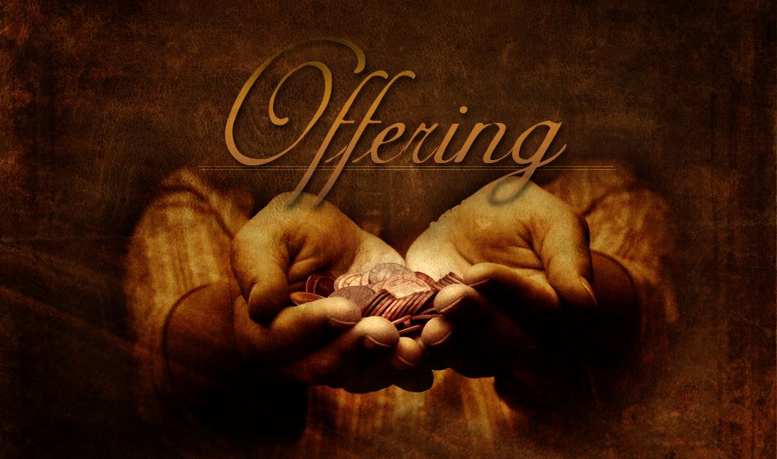
Offering

Slide 104
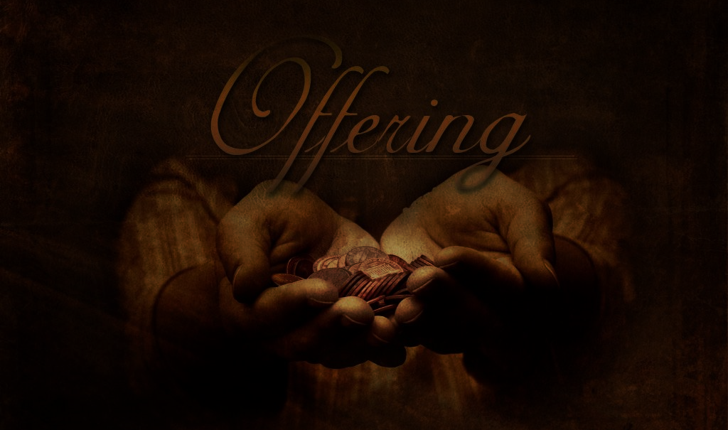
The World Day of Prayer is an ecumenical movement led
by women. The offering is part of our common vision to improve the
lives of women and children around the world. We dedicate the
offering to this ministry of prayerful action.

Slide 105
Our offerings this year will support:
Christian World Service –Developers Foundation working with
poor rural families in the Aklan Province of Philippines and Gender inequalities and COVID-19 –’–Sri Lanka.

Slide 106
The Bible Society ‘Beacon in the darkness of illiteracy’
provide literacy classes for impoverished, illiterate Christian women in Pakistan.
Interchurch Council for Hospital Chaplaincy in New Zealand.

Slide 108
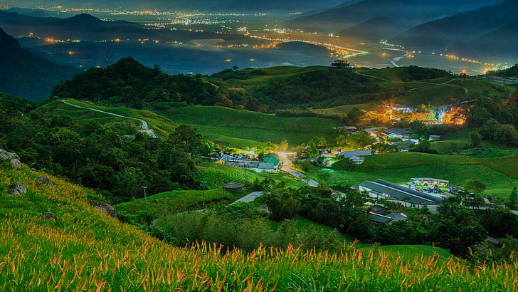
“Take my Gifts” Alleluia Aotearoa No.127
Words © Shirley Murray, Music © Colin Gibson. Used with permission.

Slide 109
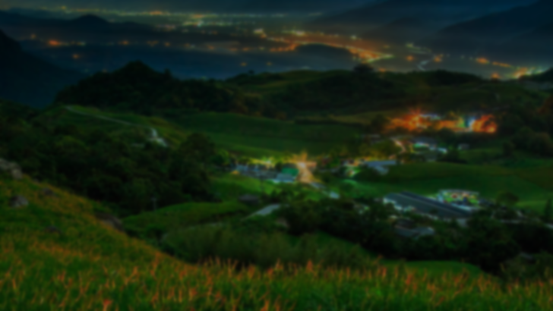
Take my gifts and let me love you,
God who first of all loved me,
gave me light and food and shelter,
gave me life and set me free.
Now, because your love has touched me,
I have love to give away;
now the bread of love is rising,
loaves of love to multiply!
Words © Shirley Murray, Music © Colin Gibson. Used with permission.

Slide 110
Take whatever I can offer –
gifts that I have yet to find,
skills that I am slow to sharpen,
talents of the hand and mind,
things made beautiful for others
in the place where I must be:
take my gifts and let me love you,
God who first of all loved me.
Words © Shirley Murray, Music © Colin Gibson. Used with permission.

Slide 113
Intercessory Prayer

Slide 114
Merciful God, Taiwan has been caught in a superpower struggle. It has been isolated internationally for decades. Though not officially recognised by the international community, Taiwan has tried its best to help the world in agriculture, technology, medicine, and humanitarian assistance.

Slide 115
O Holy Spirit, may you grant people in Taiwan strength and wisdom to cope with the uncertain future. We trust in you for Taiwan to be a blessing in the world. Divine Consoler, you are the Lord of the world; we cling to you, we give ourselves and Taiwan to you, and ask you to watch over us in our weakness. You are our fortress and place of safety.

Slide 116
Dear God of Creation, we thank you for entrusting us with this amazing world rich in natural resources. However, we ignore the cry of Mother Earth, and we are facing ecological problems, such as air and water pollution, a waste disposal crisis, over-utilization of hillsides, habitat destruction, and climate change. God of life may your kindness fill our hearts; guide us to protect Mother Earth.

Slide 117
Loving God, you created us in your own image and blessed us. You saw that it was good. We pray for women and girls who bring love and justice into the world. Holy Spirit, please give us wisdom to fight for the marginalized and the oppressed, the poor and helpless; give us courage to speak up for them and inspire leaders to create a safer place for women and girls.

Slide 118
Gracious God, the COVID-19 pandemic has been a great challenge. We pray for the ones who lost their loved ones, and the ones who did not find relief for their suffering. There are so many victims of the pandemic. God, empower us to help and bring comfort in a post-COVID-19 pandemic world.

Slide 119
Gracious God, we thank you for your good guidance during the pandemic outbreak in 2020, when under severe circumstances, WDP Taiwan prepared this worship service we are celebrating now in 2023.

Slide 120
Caring God, we thank you for granting World Day of Prayer the grace to stay together in your presence and have faith in you.

Slide 121
We are grateful for the effort of WDP women in Taiwan to overcome their differences and seek unity and consensus through God's grace. O Lord, may you guide us toward the path of unity in Christ.

Slide 123
The Lord’s Prayer (In your native tongue) From from the Taiwanese Bible

Slide 124
Só͘-í, lín tio̍h án-ni kî-tó: Goán ê Thiⁿ-pē: Goān lí ê sèng-miâ siū chun-chông.
Goān lí si-hêng chú-koân; goān lí ê chí-ì si̍t-hiān, tī tōe-chiūⁿ chhin-chhiūⁿ tī thiⁿ-téng.
Kiû lí kin-á-ji̍t sù goán su-iàu ê chia̍h-mi̍h.

Slide 125
Kiû lí sià-bián goán ê ko͘-hū, chhin-chhiūⁿ goán mā ū sià-bián ko͘-hū goán ê lâng.
Kiû lí m̄-thang hō͘ goán hām-lo̍h tam-tng bōe-khí ê chhì-thàm, kiù goán thoat-lī hit-ê Siâ-ok-chiá

Slide 127
Sending and Benediction

Slide 128
ALL:
May God hear our stories and keep us in faith.
May Jesus grant us wisdom to truly know the meaning of redemption.
May the Holy Spirit open our hearts so that we can be a blessing to
others.
Amen!

Slide 130
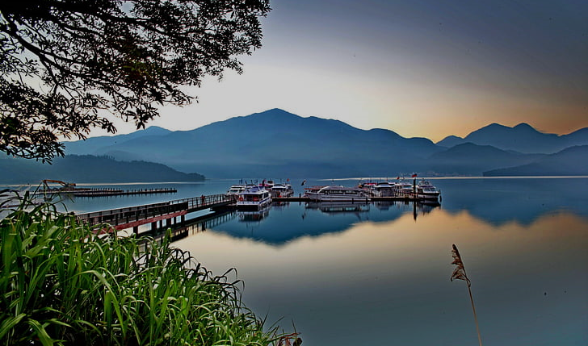
“The Day you gave us, Lord, has ended”
John Ellerton, 1870. Tune: Clement C Scholefield, 1874) (or: as adapted for a daytime service by Pat McQuillan, Auckland, 2016).

Slide 131
This day you gave us, Lord, is passing,
and night will fall at your behest;
to you our morning hymns are rising,
your praise shall sanctify our rest.
John Ellerton, 1870. Tune: Clement C Scholefield, 1874) (or: as adapted for a daytime service by Pat McQuillan, Auckland, 2016)

Slide 132
We thank you that your church unsleeping
while earth rolls onward into light,
through all the world her watch is keeping,
and rests not now by day or night.
John Ellerton, 1870. Tune: Clement C Scholefield, 1874) (or: as adapted for a daytime service by Pat McQuillan, Auckland, 2016)

Slide 133
Across each continent and island
as dawn leads on another day,
the voice of prayer is never silent,
nor dies the strain of praise away.
John Ellerton, 1870. Tune: Clement C Scholefield, 1874) (or: as adapted for a daytime service by Pat McQuillan, Auckland, 2016)

Slide 134
When we’re at rest the sun is waking
our friends beneath the western sky,
and hour by hour fresh lips are making
your wondrous doings heard on high.
John Ellerton, 1870. Tune: Clement C Scholefield, 1874) (or: as adapted for a daytime service by Pat McQuillan, Auckland, 2016)

Slide 135
So be it Lord; your throne shall never,
like earth’s proud empires, pass away;
your kingdom stands, and grows for ever,
till all your creatures own your sway.
John Ellerton, 1870. Tune: Clement C Scholefield, 1874) (or: as adapted for a daytime service by Pat McQuillan, Auckland, 2016)

Slide 137
Thanks for Joining us!

